Slide 1
Statistics Refresher
The slides contain just the important concepts. It does not involve any in-depth Mathematics

Slide 2
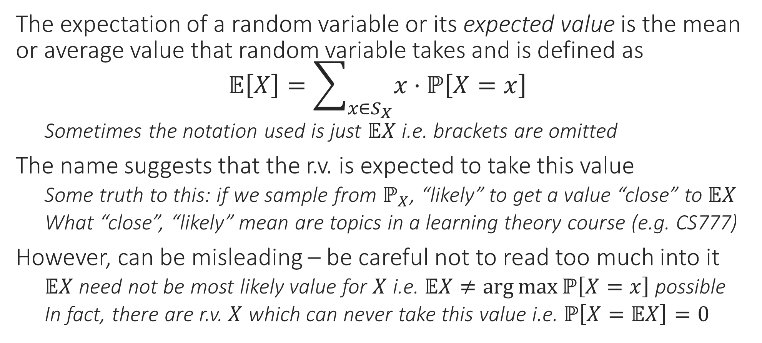
Expectation of a Random Variable
The expectation of a random variable or its expected value is the mean or average value that random variable takes and is defined as $𝔼\left[X\right]=\sum_{x∈S_{X}}{x⋅ℙ\left[X=x\right]}$
Sometimes the notation used is just $𝔼X$ i.e. brackets are omitted
The name suggests that the r.v. is expected to take this value
Some truth to this: if we sample from $ℙ_{X}$, “likely” to get a value “close” to $𝔼X$
What “close”, “likely” mean are topics in a learning theory course (e.g. CS777)
However, can be misleading – be careful not to read too much into it
$𝔼X$ need not be most likely value for $X$ i.e. $𝔼X≠\arg{\max{ℙ\left[X=x\right]}}$ possible
In fact, there are r.v. $X$ which can never take this value i.e. $ℙ\left[X=𝔼X\right]=0$

Slide 3
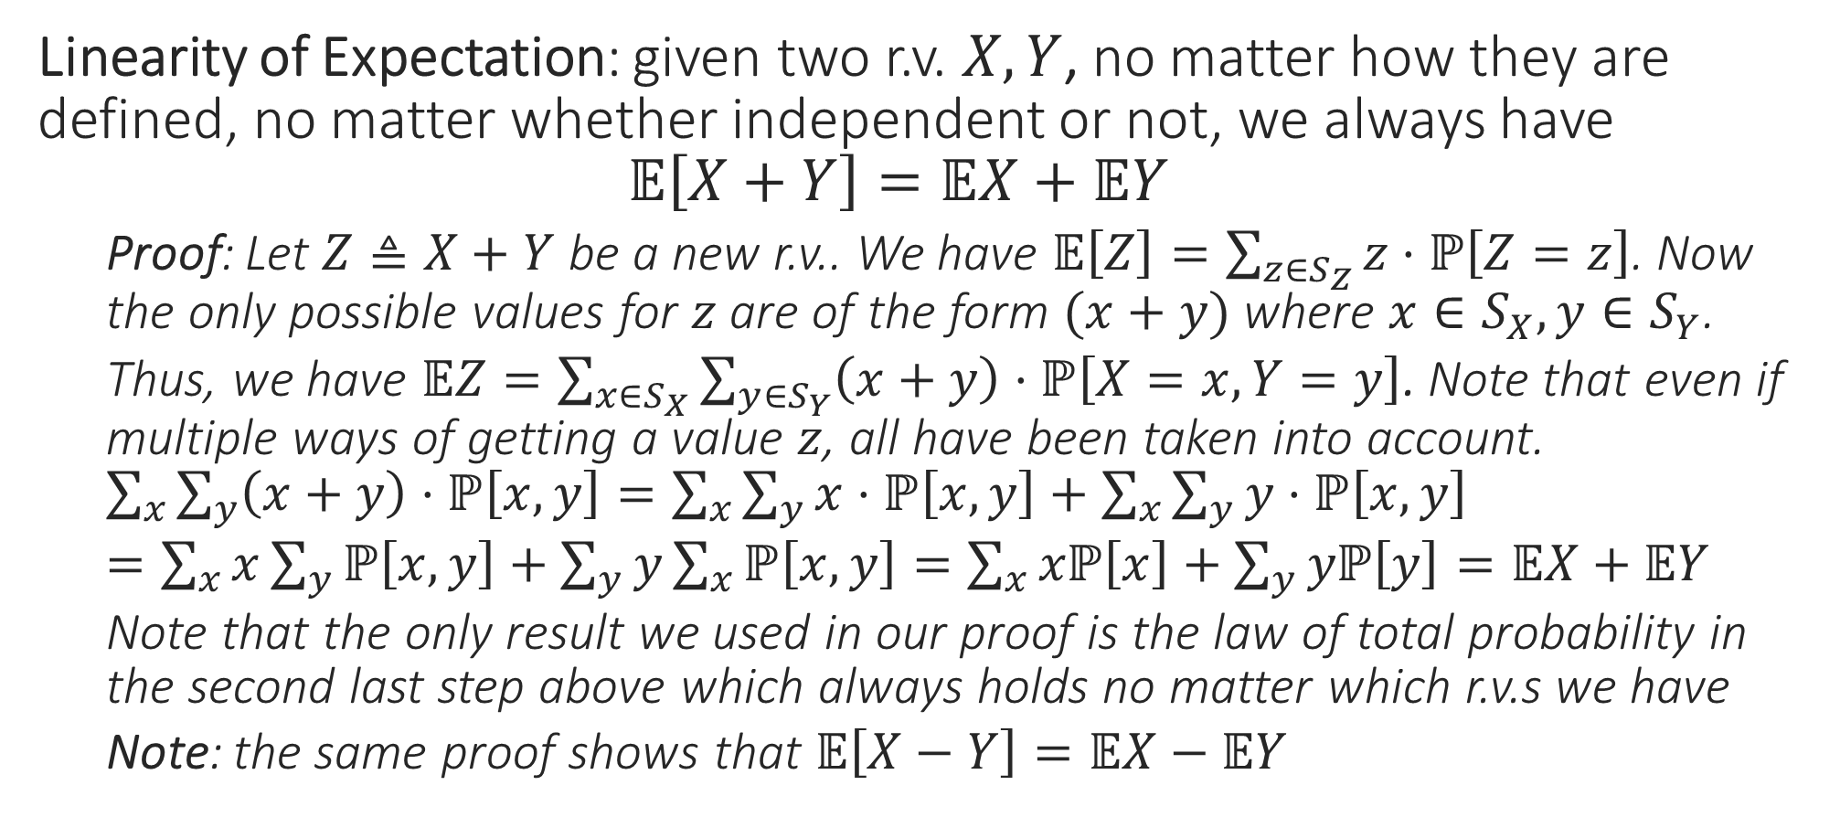
Rules of Expectation: Sum Rule
Linearity of Expectation: given two r.v. $X,Y$, no matter how they are defined, no matter whether independent or not, we always have $𝔼\left[X+Y\right]=𝔼X+𝔼Y$
Proof: Let $Z≜X+Y$ be a new r.v.. We have $𝔼\left[Z\right]=\sum_{z∈S_{Z}}{z⋅ℙ\left[Z=z\right]}$. Now the only possible values for $z$ are of the form $(x+y)$ where $x∈S_{X},y∈S_{Y}$.
Thus, we have $𝔼Z=\sum_{x∈S_{X}}{\sum_{y∈S_{Y}}{\left(x+y\right)⋅ℙ\left[X=x,Y=y\right]}}$. Note that even if multiple ways of getting a value $z$, all have been taken into account. $\sum_{x}{\sum_{y}{\left(x+y\right)⋅ℙ\left[x,y\right]}}=\sum_{x}{\sum_{y}{x⋅ℙ\left[x,y\right]}}+\sum_{x}{\sum_{y}{y⋅ℙ\left[x,y\right]}}$
$=\sum_{x}{x\sum_{y}{ℙ\left[x,y\right]}}+\sum_{y}{y\sum_{x}{ℙ\left[x,y\right]}}=\sum_{x}{xℙ\left[x\right]}+\sum_{y}{yℙ\left[y\right]}=𝔼X+𝔼Y$
Note that the only result we used in our proof is the law of total probability in the second last step above which always holds no matter which r.v.s we have
Note: the same proof shows that $𝔼\left[X−Y\right]=𝔼X−𝔼Y$

Slide 4
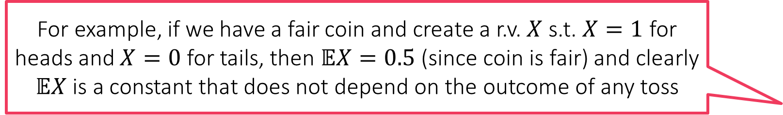
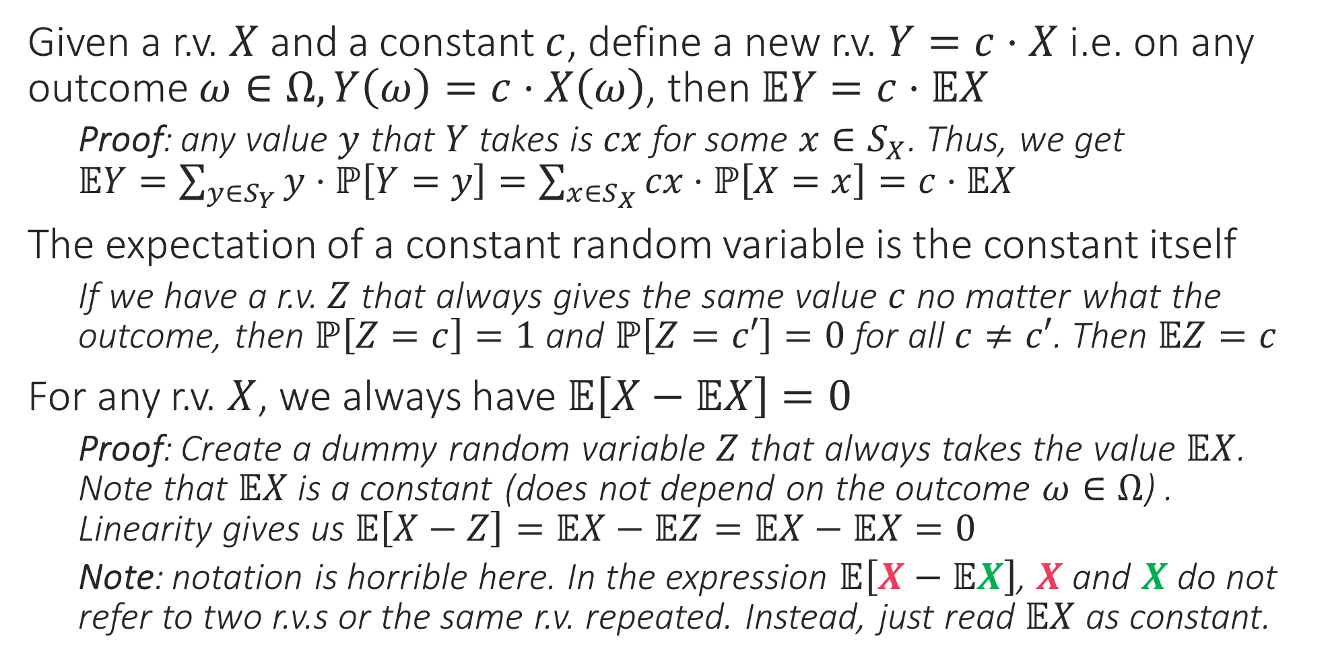
Rules of Expectation: Scaling Rule
Given a r.v. $X$ and a constant $c$, define a new r.v. $Y=c⋅X$ i.e. on any outcome $ω∈Ω,Y\left(ω\right)=c⋅X\left(ω\right)$, then $𝔼Y=c⋅𝔼X$
Proof: any value $y$ that $Y$ takes is $cx$ for some $x∈S_{X}$. Thus, we get $𝔼Y=\sum_{y∈S_{Y}}{y⋅ℙ\left[Y=y\right]}=\sum_{x∈S_{X}}{cx⋅ℙ\left[X=x\right]}=c⋅𝔼X$
The expectation of a constant random variable is the constant itself
If we have a r.v. $Z$ that always gives the same value $c$ no matter what the outcome, then $ℙ\left[Z=c\right]=1$ and $ℙ\left[Z=c′\right]=0$ for all $c≠c′$. Then $𝔼Z=c$
For any r.v. $X$, we always have $𝔼\left[X−𝔼X\right]=0$
Proof: Create a dummy random variable $Z$ that always takes the value $𝔼X$. Note that $𝔼X$ is a constant (does not depend on the outcome $ω∈Ω$) . Linearity gives us $𝔼\left[X−Z\right]=𝔼X−𝔼Z=𝔼X−𝔼X=0$
Note: notation is horrible here. In the expression $𝔼\left[X−𝔼X\right]$, $X$ and $X$ do not refer to two r.v.s or the same r.v. repeated. Instead, just read $𝔼X$ as constant.
For example, if we have a fair coin and create a r.v. $X$ s.t. $X=1$ for heads and $X=0$ for tails, then $𝔼X=0.5$ (since coin is fair) and clearly $𝔼X$ is a constant that does not depend on the outcome of any toss

Slide 5
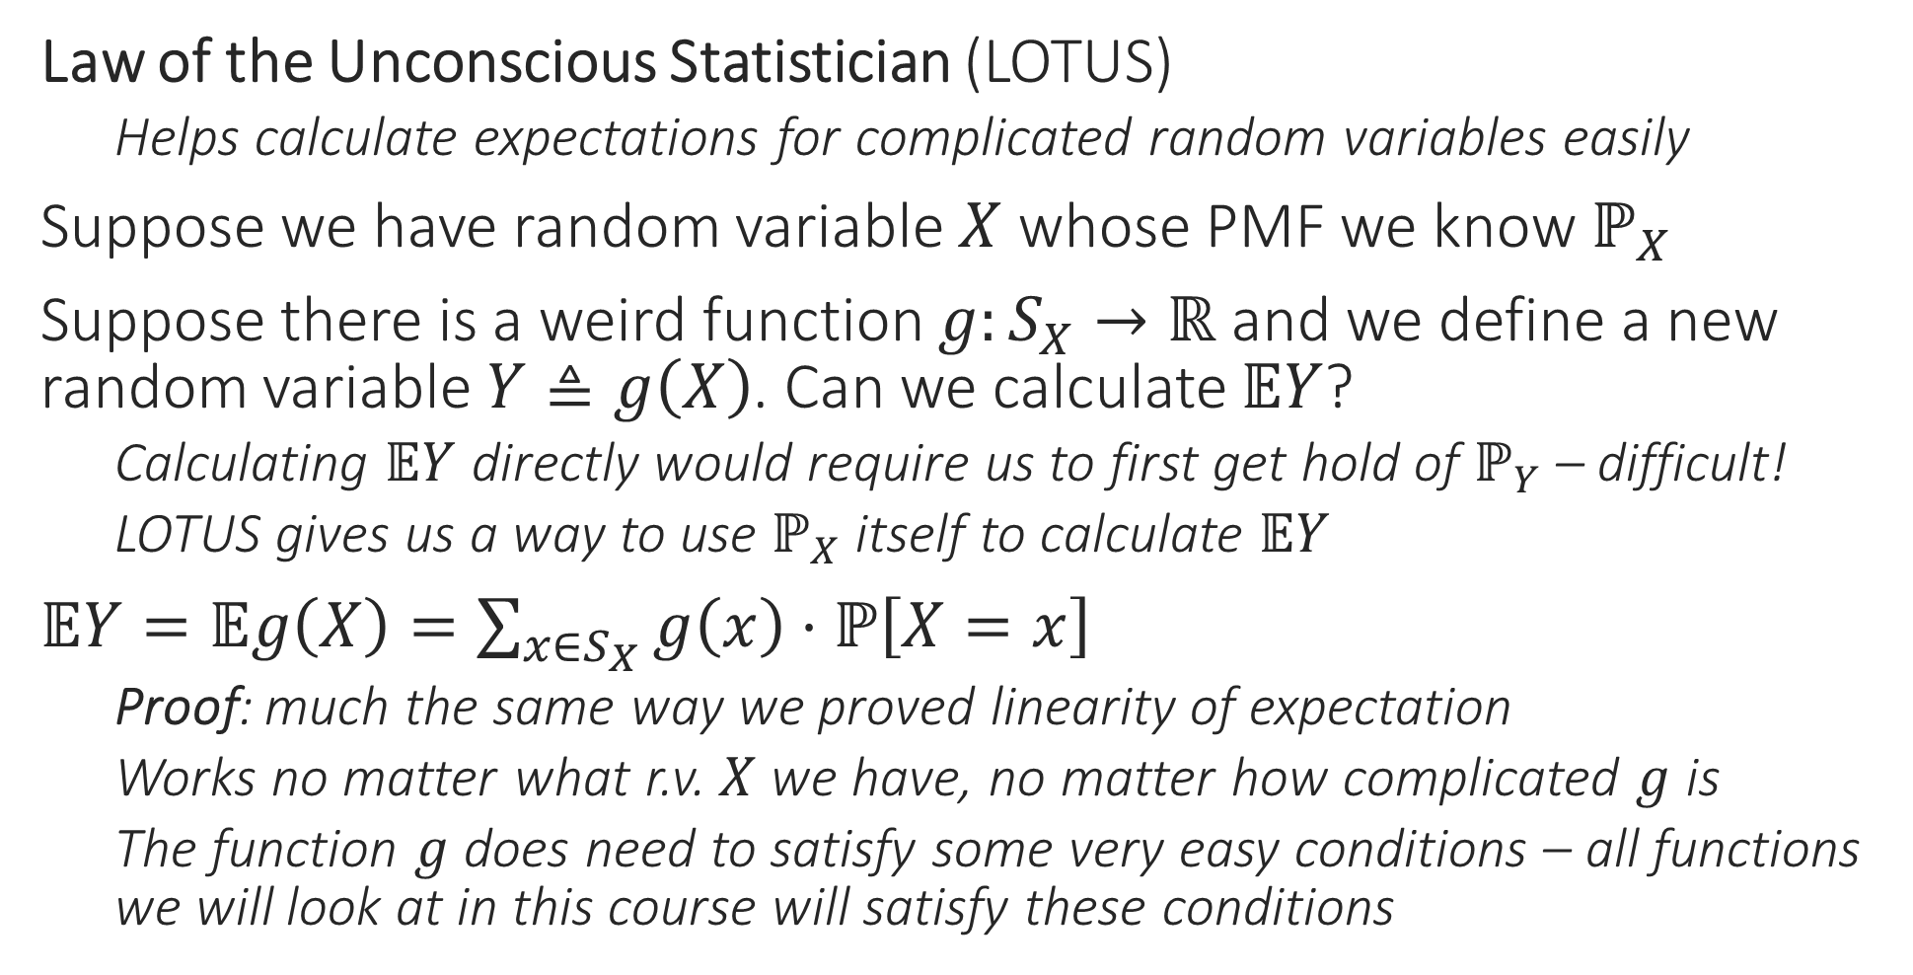
Rules of Expectation
Law of the Unconscious Statistician (LOTUS)
Helps calculate expectations for complicated random variables easily
Suppose we have random variable $X$ whose PMF we know $ℙ_{X}$
Suppose there is a weird function $g:S_{X}→ℝ$ and we define a new random variable $Y≜g\left(X\right)$. Can we calculate $𝔼Y$?
Calculating $𝔼Y$ directly would require us to first get hold of $ℙ_{Y}$ – difficult!
LOTUS gives us a way to use $ℙ_{X}$ itself to calculate $𝔼Y$
$𝔼Y=𝔼g\left(X\right)=\sum_{x∈S_{X}}{g\left(x\right)⋅ℙ\left[X=x\right]}$
Proof: much the same way we proved linearity of expectation
Works no matter what r.v. $X$ we have, no matter how complicated $g$ is
The function $g$ does need to satisfy some very easy conditions – all functions we will look at in this course will satisfy these conditions

Slide 6
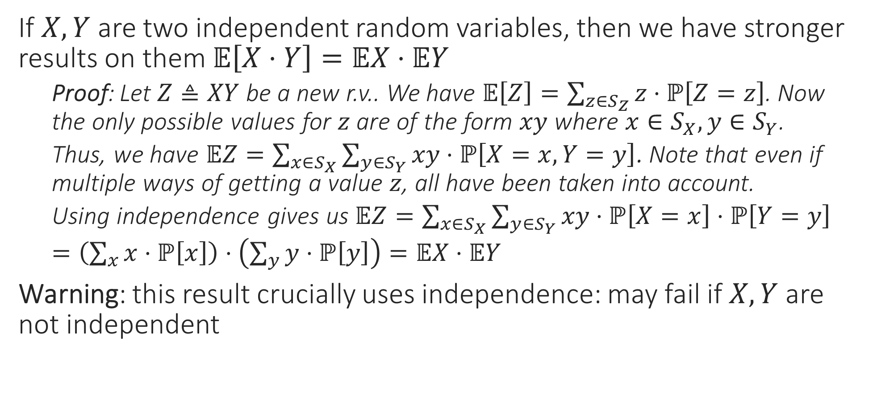
Rules of Expectation: Product Rule
If $X,Y$ are two independent random variables, then we have stronger results on them $𝔼\left[X⋅Y\right]=𝔼X⋅𝔼Y$
Proof: Let $Z≜XY$ be a new r.v.. We have $𝔼\left[Z\right]=\sum_{z∈S_{Z}}{z⋅ℙ\left[Z=z\right]}$. Now the only possible values for $z$ are of the form $xy$ where $x∈S_{X},y∈S_{Y}$.
Thus, we have $𝔼Z=\sum_{x∈S_{X}}{\sum_{y∈S_{Y}}{xy⋅ℙ\left[X=x,Y=y\right]}}$. Note that even if multiple ways of getting a value $z$, all have been taken into account.
Using independence gives us $𝔼Z=\sum_{x∈S_{X}}{\sum_{y∈S_{Y}}{xy⋅ℙ\left[X=x\right]⋅ℙ\left[Y=y\right]}}$
$=\left(\sum_{x}{x⋅ℙ\left[x\right]}\right)⋅\left(\sum_{y}{y⋅ℙ\left[y\right]}\right)=𝔼X⋅𝔼Y$
Warning: this result crucially uses independence: may fail if $X,Y$ are not independent

Slide 7


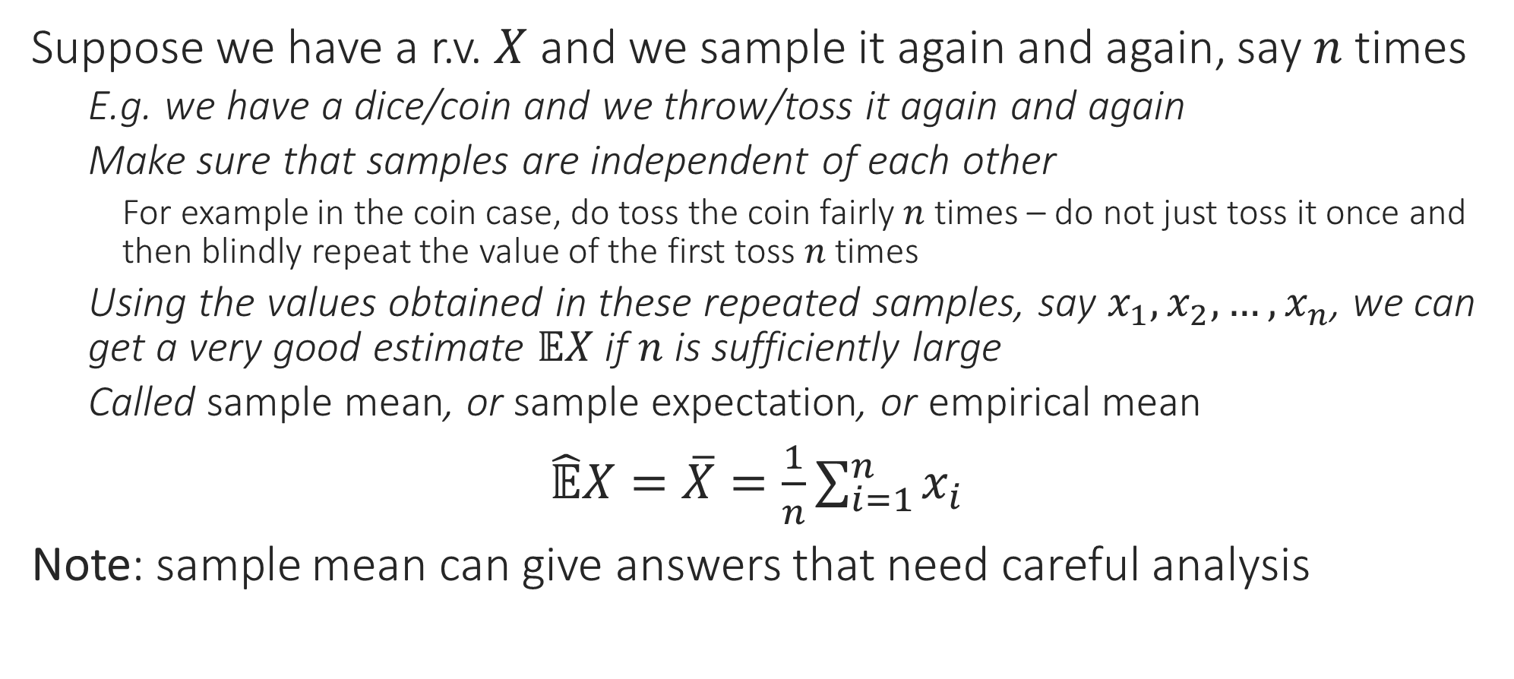

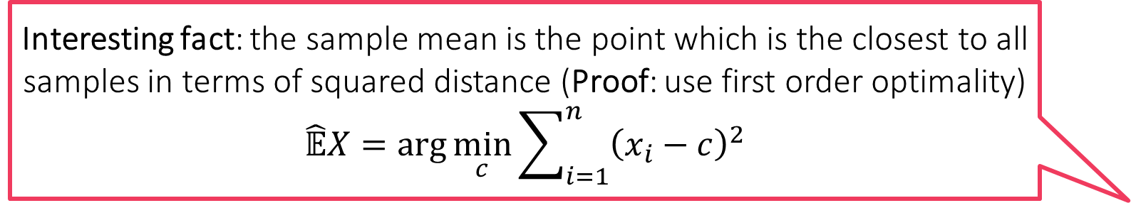
Sample Mean
Indeed! If we ask 1000 random Indians, how many children they have, the sample mean might come out to be 2.35. However, no Indian can have 2.35 children since number of children has to be an integer!
Suppose we have a r.v. $X$ and we sample it again and again, say $n$ times
E.g. we have a dice/coin and we throw/toss it again and again
Make sure that samples are independent of each other
For example in the coin case, do toss the coin fairly $n$ times – do not just toss it once and then blindly repeat the value of the first toss $n$times
Using the values obtained in these repeated samples, say $x_{1},x_{2},…,x_{n}$, we can get a very good estimate $𝔼X$ if $n$ is sufficiently large
Called sample mean, or sample expectation, or empirical mean
$\hat{𝔼}X=\overline{X}=\frac{1}{n}\sum_{i=1}^{n}{x_{i}}$
Note: sample mean can give answers that need careful analysis
Yes, that is why we warned not to take expectation/sample mean literally. All that your experiment tells you is that most Indians have around 2.35 children. Some may have much more (e.g. 7) or much less (e.g. 0) but they are usually rarer
Interesting fact: the sample mean is the point which is the closest to all samples in terms of squared distance (Proof: use first order optimality) $$\hat{𝔼}X=\arg{\min_{c}{\sum_{i=1}^{n}{{\left(x_{i}−c\right)}^{2}}}}$$
Interesting fact: even the mean itself satisfies the nice property $$𝔼X=\arg{\min_{c}{𝔼\left[{\left(X−c\right)}^{2}\right]}}$$

Slide 8
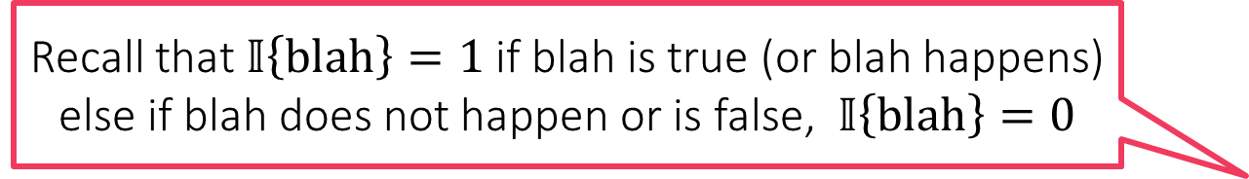
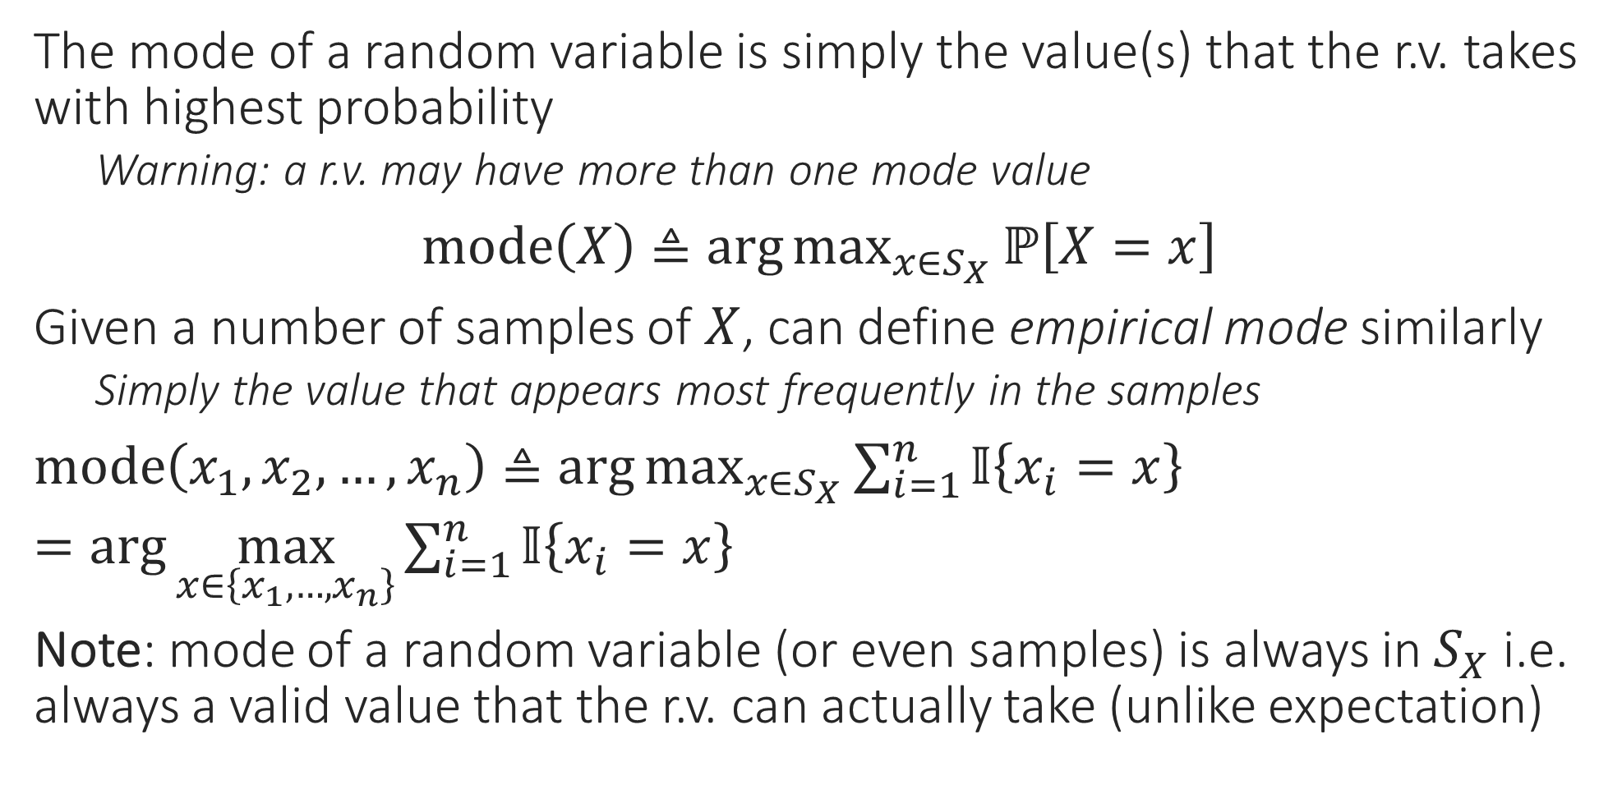
Mode of a Random Variable
The mode of a random variable is simply the value(s) that the r.v. takes with highest probability
Warning: a r.v. may have more than one mode value
$mode\left(X\right)≜\arg{\max_{x∈S_{X}}{ℙ\left[X=x\right]}}$
Given a number of samples of $X$, can define empirical mode similarly
Simply the value that appears most frequently in the samples
$mode\left(x_{1},x_{2},…,x_{n}\right)≜\arg{\max_{x∈S_{X}}{\sum_{i=1}^{n}{𝕀\left\{x_{i}=x\right\}}}}$
$=\arg{\max_{x∈\left\{x_{1},…,x_{n}\right\}}{\sum_{i=1}^{n}{𝕀\left\{x_{i}=x\right\}}}}$
Note: mode of a random variable (or even samples) is always in $S_{X}$ i.e. always a valid value that the r.v. can actually take (unlike expectation)
Recall that $𝕀\left\{blah\right\}=1$ if blah is true (or blah happens) else if blah does not happen or is false, $𝕀\left\{blah\right\}=0$

Slide 9

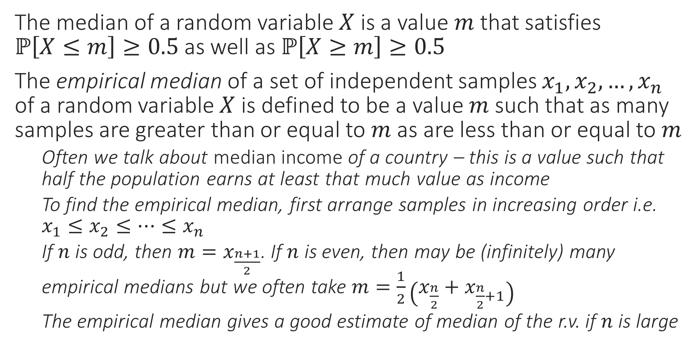


Median of a Random Variable
Interesting Fact: The empirical median is the point which is the closest to all samples in terms of absolute distance (Proof: in notes) $$\hat{𝔼}X=\arg{\min_{c}{\sum_{i=1}^{n}{\left|x_{i}−c\right|}}}$$
The median of a random variable $X$ is a value $m$ that satisfies $ℙ\left[X≤m\right]≥0.5$ as well as $ℙ\left[X≥m\right]≥0.5$
The empirical median of a set of independent samples $x_{1},x_{2},…,x_{n}$ of a random variable $X$ is defined to be a value $m$ such that as many samples are greater than or equal to $m$ as are less than or equal to $m$
Often we talk about median income of a country – this is a value such that half the population earns at least that much value as income
To find the empirical median, first arrange samples in increasing order i.e. $x_{1}≤x_{2}≤…≤x_{n}$
If $n$ is odd, then $m=x_{\frac{n+1}{2}}$. If $n$ is even, then may be (infinitely) many empirical medians but we often take $m=\frac{1}{2}\left(x_{\frac{n}{2}}+x_{\frac{n}{2}+1}\right)$
The empirical median gives a good estimate of median of the r.v. if $n$ is large
Interesting fact: even the median itself satisfies the nice property $$𝔼X=\arg{\min_{c}{𝔼\left[\left|X−c\right|\right]}}$$

Slide 10
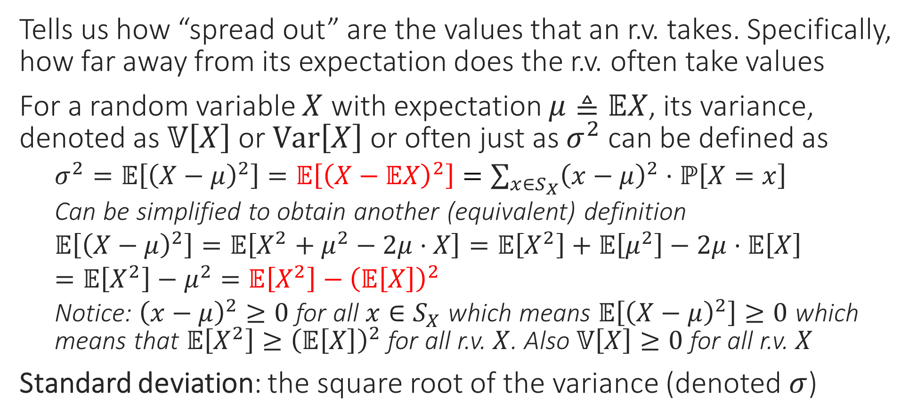
Variance
Tells us how “spread out” are the values that an r.v. takes. Specifically, how far away from its expectation does the r.v. often take values
For a random variable $X$ with expectation $μ≜𝔼X$, its variance, denoted as $𝕍\left[X\right]$ or $Var\left[X\right]$ or often just as $σ^{2}$ can be defined as
$σ^{2}=𝔼\left[{\left(X−μ\right)}^{2}\right]=𝔼\left[{\left(X−𝔼X\right)}^{2}\right]=\sum_{x∈S_{X}}{{\left(x−μ\right)}^{2}⋅ℙ\left[X=x\right]}$
Can be simplified to obtain another (equivalent) definition
$𝔼\left[{\left(X−μ\right)}^{2}\right]=𝔼\left[X^{2}+μ^{2}−2μ⋅X\right]=𝔼\left[X^{2}\right]+𝔼\left[μ^{2}\right]−2μ⋅𝔼\left[X\right]$
$=𝔼\left[X^{2}\right]−μ^{2}=𝔼\left[X^{2}\right]−{\left(𝔼\left[X\right]\right)}^{2}$
Notice: ${\left(x−μ\right)}^{2}≥0$ for all $x∈S_{X}$ which means $𝔼\left[{\left(X−μ\right)}^{2}\right]≥0$ which means that $𝔼\left[X^{2}\right]≥{\left(𝔼\left[X\right]\right)}^{2}$ for all r.v. $X$. Also $𝕍\left[X\right]≥0$ for all r.v. $X$
Standard deviation: the square root of the variance (denoted $σ$)

Slide 11
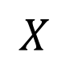
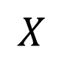
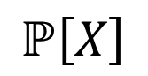
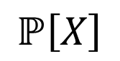
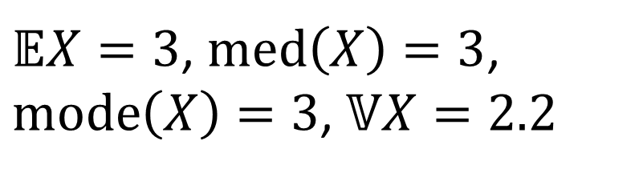
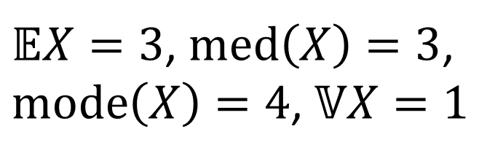
Example
$$ℙ\left[X\right]$$
$$ℙ\left[X\right]$$
0 0.1 0.2 0.3 0.4
0 0.1 0.2 0.3 0.4
0 1 2 3 4 5 6
$$X$$
0 1 2 3 4 5 6
$$X$$
$𝔼X=3$, $med\left(X\right)=3$, $mode\left(X\right)=4$, $𝕍X=1$
$𝔼X=3$, $med\left(X\right)=3$, $mode\left(X\right)=3$, $𝕍X=2.2$
This distribution has the same mean and median as the first one but is more “spread out” hence larger variance

Slide 12
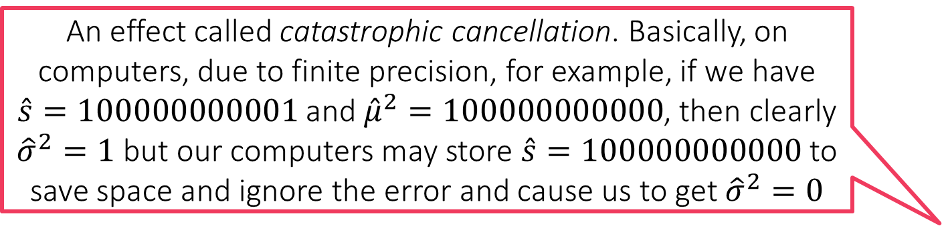
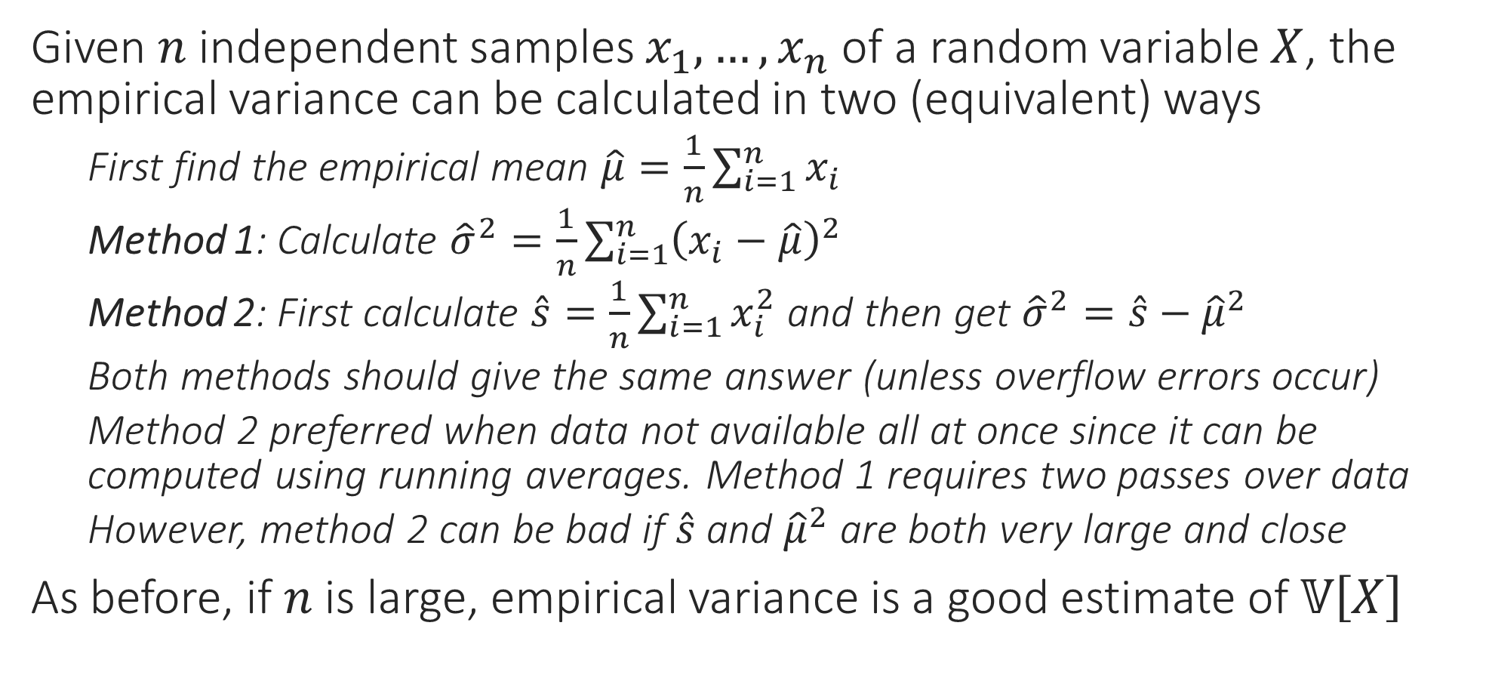
Sample Variance
Given $n$ independent samples $x_{1},…,x_{n}$ of a random variable $X$, the empirical variance can be calculated in two (equivalent) ways
First find the empirical mean $\hat{μ}=\frac{1}{n}\sum_{i=1}^{n}{x_{i}}$
Method 1: Calculate ${\hat{σ}}^{2}=\frac{1}{n}\sum_{i=1}^{n}{{\left(x_{i}−\hat{μ}\right)}^{2}}$
Method 2: First calculate $\hat{s}=\frac{1}{n}\sum_{i=1}^{n}{x_{i}^{2}}$ and then get ${\hat{σ}}^{2}=\hat{s}−{\hat{μ}}^{2}$
Both methods should give the same answer (unless overflow errors occur)
Method 2 preferred when data not available all at once since it can be computed using running averages. Method 1 requires two passes over data
However, method 2 can be bad if $\hat{s}$ and ${\hat{μ}}^{2}$ are both very large and close
As before, if $n$ is large, empirical variance is a good estimate of $𝕍\left[X\right]$
An effect called catastrophic cancellation. Basically, on computers, due to finite precision, for example, if we have $\hat{s}=100000000001$ and ${\hat{μ}}^{2}=100000000000$, then clearly ${\hat{σ}}^{2}=1$ but our computers may store $\hat{s}=100000000000$ to save space and ignore the error and cause us to get ${\hat{σ}}^{2}=0$

Slide 13
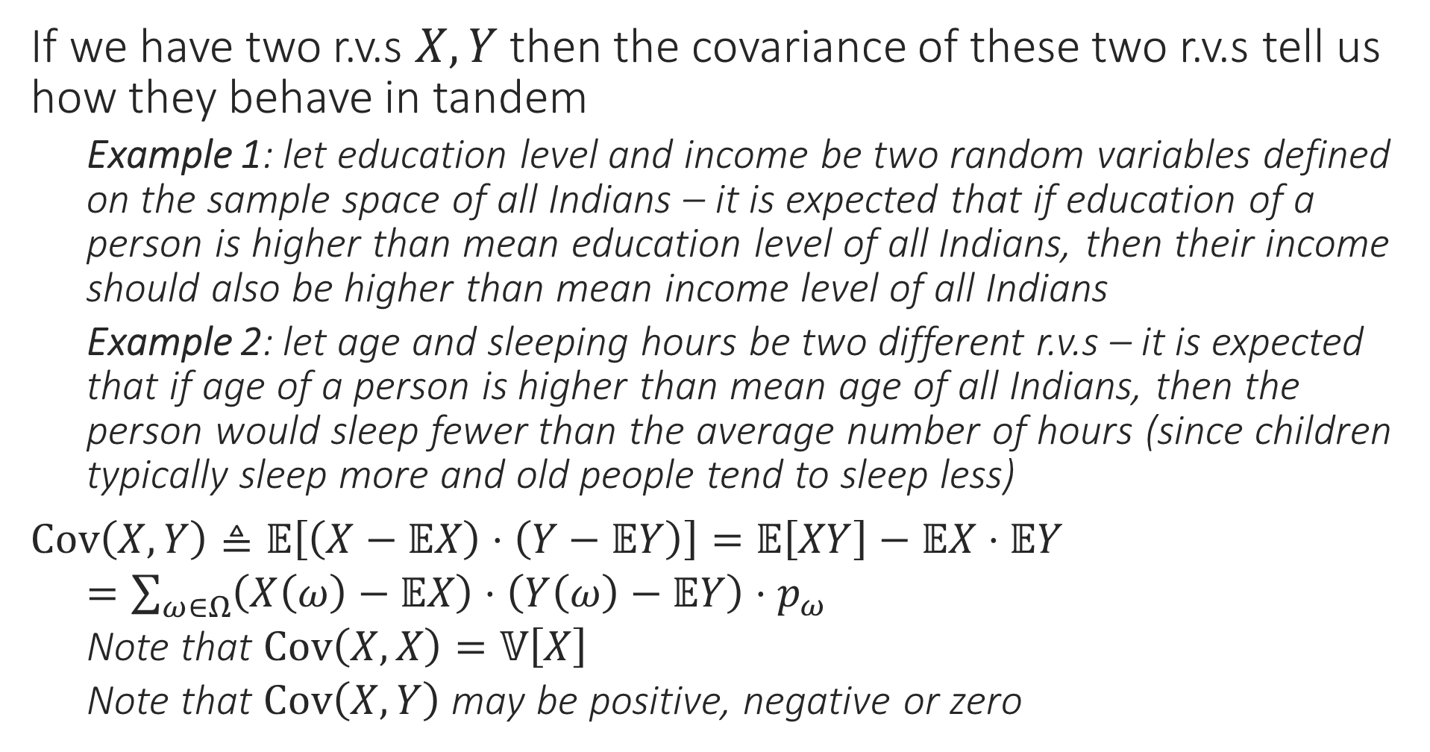
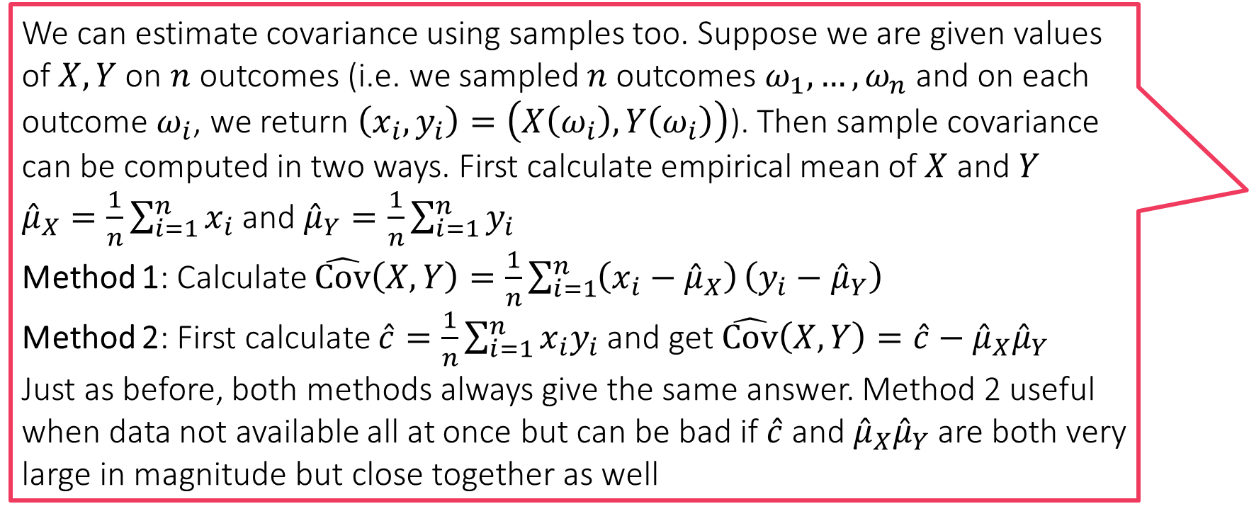
Covariance
We can estimate covariance using samples too. Suppose we are given values of $X,Y$ on $n$ outcomes (i.e. we sampled $n$ outcomes $ω_{1},…,ω_{n}$ and on each outcome $ω_{i}$, we return $\left(x_{i},y_{i}\right)=\left(X\left(ω_{i}\right),Y\left(ω_{i}\right)\right)$). Then sample covariance can be computed in two ways. First calculate empirical mean of $X$ and $Y$
${\hat{μ}}_{X}=\frac{1}{n}\sum_{i=1}^{n}{x_{i}}$ and ${\hat{μ}}_{Y}=\frac{1}{n}\sum_{i=1}^{n}{y_{i}}$
Method 1: Calculate $\hat{Cov}\left(X,Y\right)=\frac{1}{n}\sum_{i=1}^{n}{\left(x_{i}−{\hat{μ}}_{X}\right)}\left(y_{i}−{\hat{μ}}_{Y}\right)$
Method 2: First calculate $\hat{c}=\frac{1}{n}\sum_{i=1}^{n}{x_{i}y_{i}}$ and get $\hat{Cov}\left(X,Y\right)=\hat{c}−{\hat{μ}}_{X}{\hat{μ}}_{Y}$
Just as before, both methods always give the same answer. Method 2 useful when data not available all at once but can be bad if $\hat{c}$ and ${\hat{μ}}_{X}{\hat{μ}}_{Y}$ are both very large in magnitude but close together as well
If we have two r.v.s $X,Y$ then the covariance of these two r.v.s tell us how they behave in tandem
Example 1: let education level and income be two random variables defined on the sample space of all Indians – it is expected that if education of a person is higher than mean education level of all Indians, then their income should also be higher than mean income level of all Indians
Example 2: let age and sleeping hours be two different r.v.s – it is expected that if age of a person is higher than mean age of all Indians, then the person would sleep fewer than the average number of hours (since children typically sleep more and old people tend to sleep less)
$Cov\left(X,Y\right)≜𝔼\left[\left(X−𝔼X\right)⋅\left(Y−𝔼Y\right)\right]=𝔼\left[XY\right]−𝔼X⋅𝔼Y$
$=\sum_{ω∈Ω}{\left(X\left(ω\right)−𝔼X\right)⋅\left(Y\left(ω\right)−𝔼Y\right)⋅p_{ω}}$
Note that $Cov\left(X,X\right)=𝕍\left[X\right]$
Note that $Cov\left(X,Y\right)$ may be positive, negative or zero

Slide 14
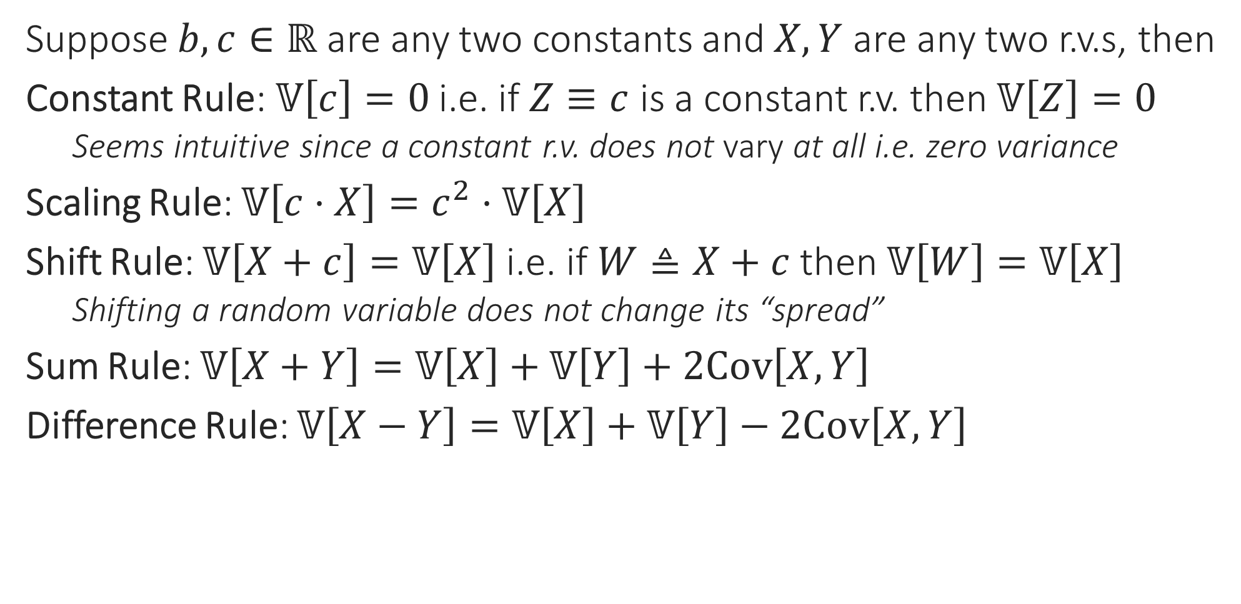
Rules of Variance
Suppose $b,c∈ℝ$ are any two constants and $X,Y$ are any two r.v.s, then
Constant Rule: $𝕍\left[c\right]=0$ i.e. if $Z≡c$ is a constant r.v. then $𝕍\left[Z\right]=0$
Seems intuitive since a constant r.v. does not vary at all i.e. zero variance
Scaling Rule: $𝕍\left[c⋅X\right]=c^{2}⋅𝕍\left[X\right]$
Shift Rule: $𝕍\left[X+c\right]=𝕍\left[X\right]$ i.e. if $W≜X+c$ then $𝕍\left[W\right]=𝕍\left[X\right]$
Shifting a random variable does not change its “spread”
Sum Rule: $𝕍\left[X+Y\right]=𝕍\left[X\right]+𝕍\left[Y\right]+2Cov\left[X,Y\right]$
Difference Rule: $𝕍\left[X−Y\right]=𝕍\left[X\right]+𝕍\left[Y\right]−2Cov\left[X,Y\right]$
Often used to deal with catastrophic cancellation by shifting the data to make it smaller in magnitude but leaving variance unchanged

Slide 15

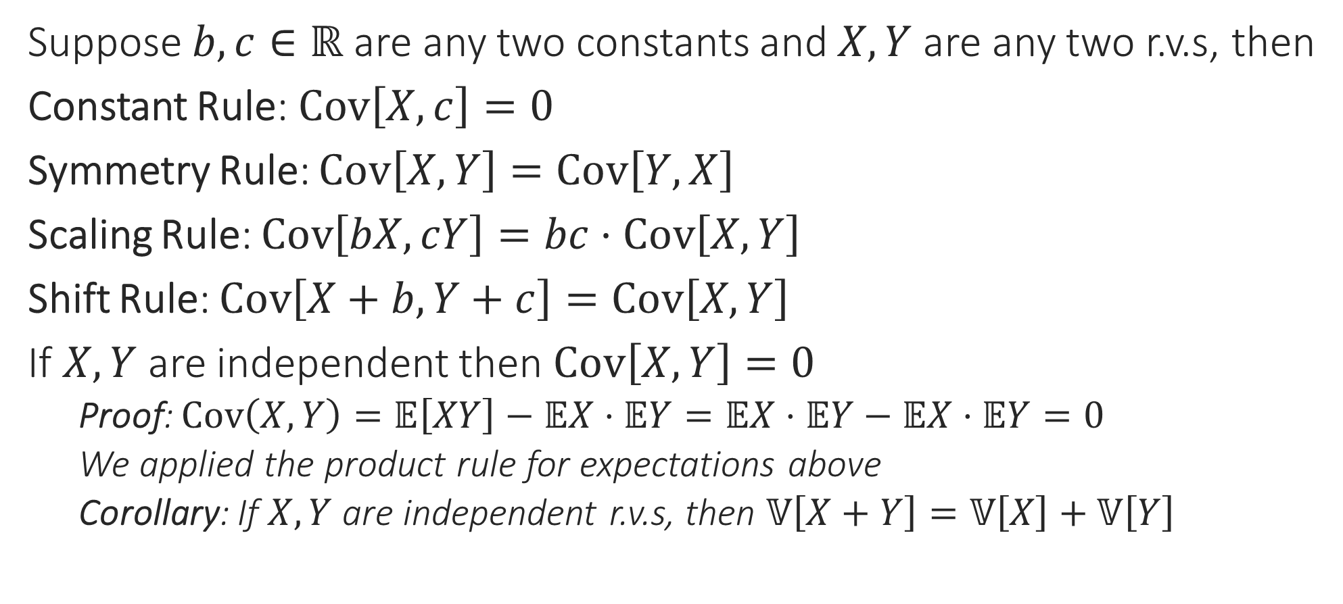
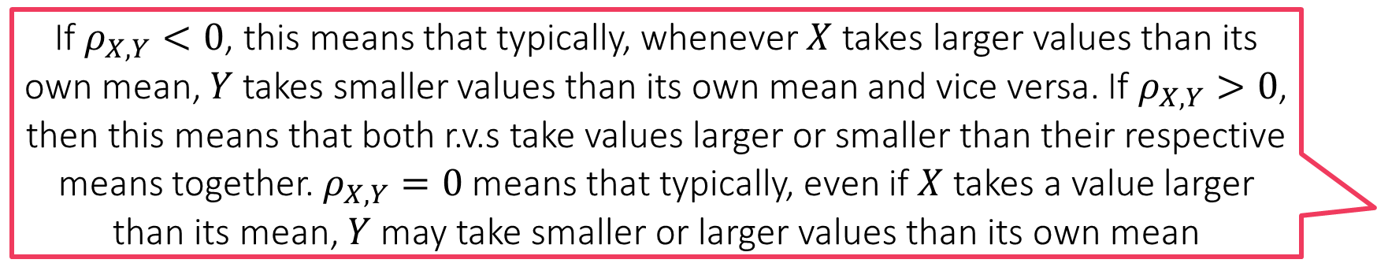
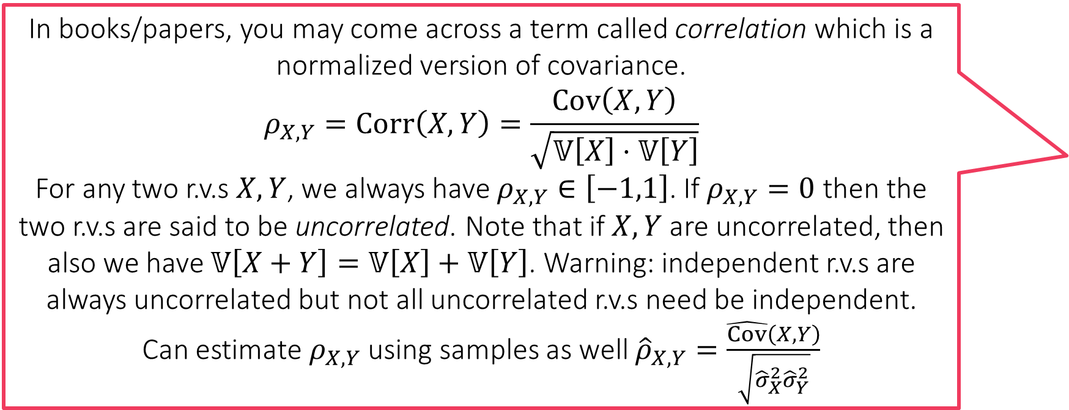
Rules of Covariance
In books/papers, you may come across a term called correlation which is a normalized version of covariance.
$$ρ_{X,Y}=Corr\left(X,Y\right)=\frac{Cov\left(X,Y\right)}{\sqrt{𝕍\left[X\right]⋅𝕍\left[Y\right]}}$$
For any two r.v.s $X,Y$, we always have $ρ_{X,Y}∈\left[−1,1\right]$. If $ρ_{X,Y}=0$ then the two r.v.s are said to be uncorrelated. Note that if $X,Y$ are uncorrelated, then also we have $𝕍\left[X+Y\right]=𝕍\left[X\right]+𝕍\left[Y\right]$. Warning: independent r.v.s are always uncorrelated but not all uncorrelated r.v.s need be independent.
Can estimate $ρ_{X,Y}$ using samples as well ${\hat{ρ}}_{X,Y}=\frac{\hat{Cov}\left(X,Y\right)}{\sqrt{{\hat{σ}}_{X}^{2}{\hat{σ}}_{Y}^{2}}}$
Suppose $b,c∈ℝ$ are any two constants and $X,Y$ are any two r.v.s, then
Constant Rule: $Cov\left[X,c\right]=0$
Symmetry Rule: $Cov\left[X,Y\right]=Cov\left[Y,X\right]$
Scaling Rule: $Cov\left[bX,cY\right]=bc⋅Cov\left[X,Y\right]$
Shift Rule: $Cov\left[X+b,Y+c\right]=Cov\left[X,Y\right]$
If $X,Y$ are independent then $Cov\left[X,Y\right]=0$
Proof: $Cov\left(X,Y\right)=𝔼\left[XY\right]−𝔼X⋅𝔼Y=𝔼X⋅𝔼Y−𝔼X⋅𝔼Y=0$
We applied the product rule for expectations above
Corollary: If $X,Y$ are independent r.v.s, then $𝕍\left[X+Y\right]=𝕍\left[X\right]+𝕍\left[Y\right]$
If $ρ_{X,Y}<0$, this means that typically, whenever $X$ takes larger values than its own mean, $Y$ takes smaller values than its own mean and vice versa. If $ρ_{X,Y}>0$, then this means that both r.v.s take values larger or smaller than their respective means together. $ρ_{X,Y}=0$ means that typically, even if $X$ takes a value larger than its mean, $Y$ may take smaller or larger values than its own mean

Slide 16
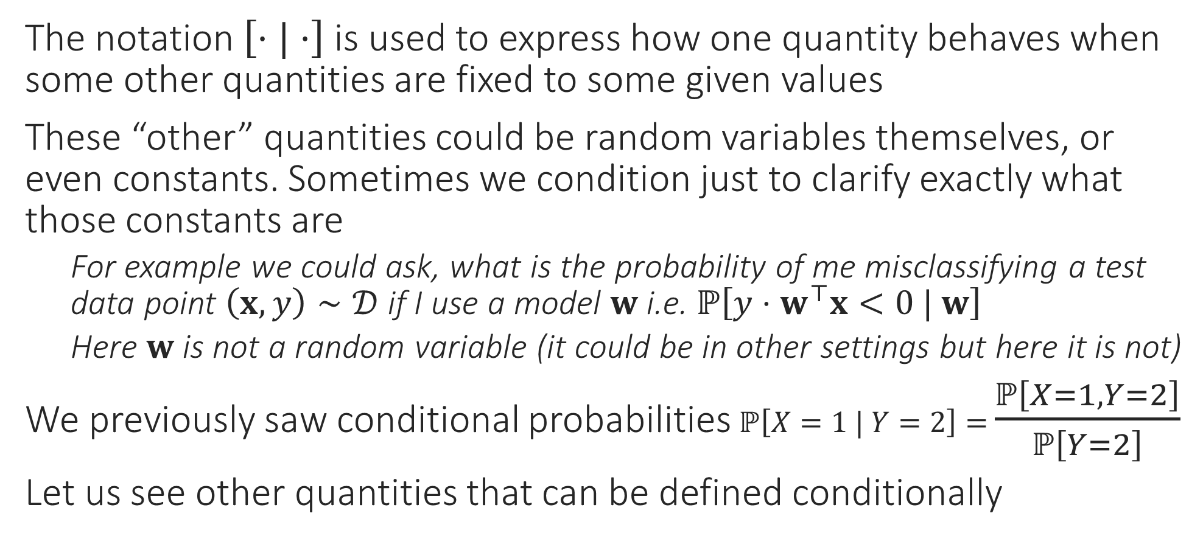
Conditional Statistics
The notation $\left[⋅|⋅\right]$ is used to express how one quantity behaves when some other quantities are fixed to some given values
These “other” quantities could be random variables themselves, or even constants. Sometimes we condition just to clarify exactly what those constants are
For example we could ask, what is the probability of me misclassifying a test data point $\left(x,y\right)∼𝒟$ if I use a model $w$ i.e. $ℙ\left[y⋅w^{⊤}x<0 | w\right]$
Here $w$ is not a random variable (it could be in other settings but here it is not)
We previously saw conditional probabilities $ℙ\left[X=1 | Y=2\right]=$ $\frac{ℙ\left[X=1,Y=2\right]}{ℙ\left[Y=2\right]}$
Let us see other quantities that can be defined conditionally

Slide 17
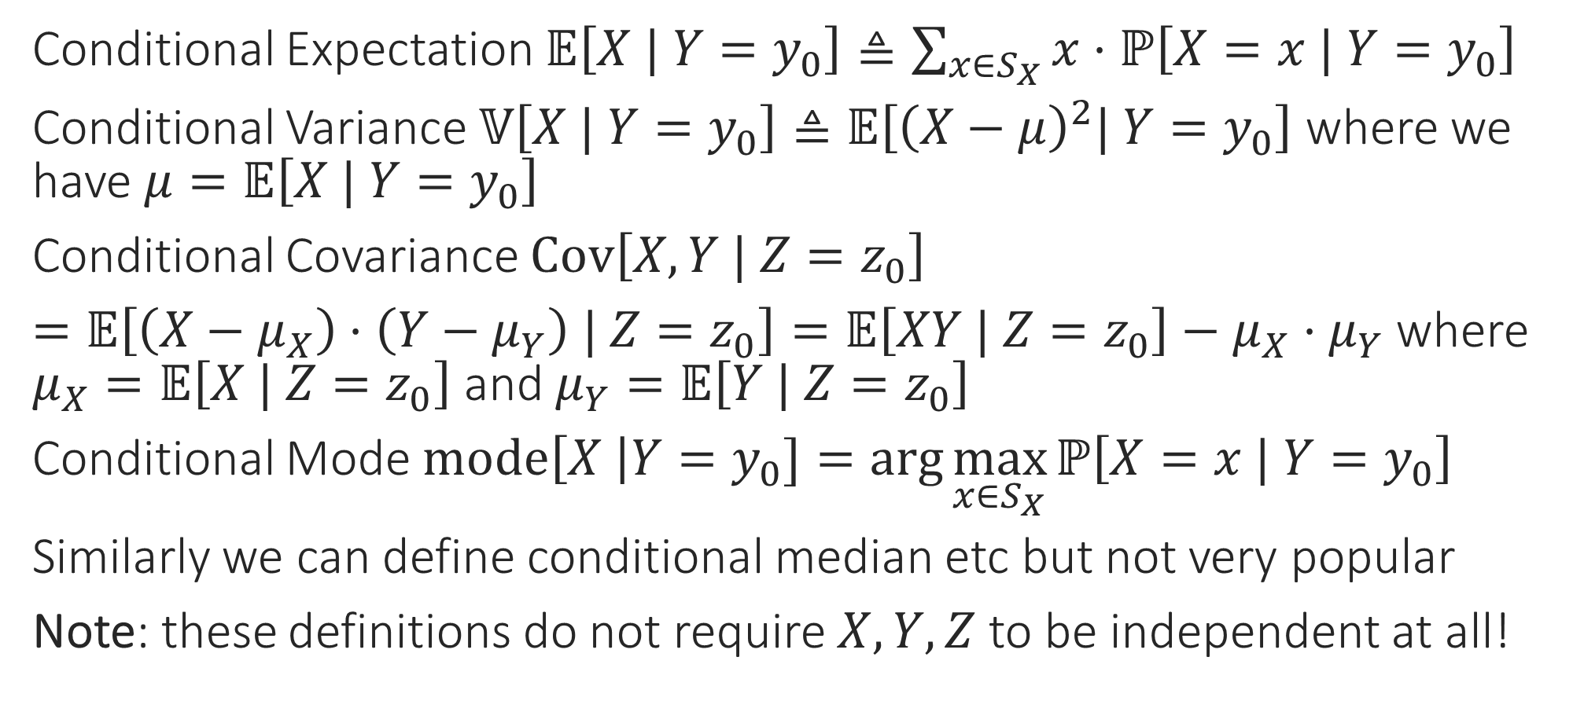
Conditional Statistics
Conditional Expectation $𝔼\left[X | Y=y_{0}\right]≜\sum_{x∈S_{X}}{x⋅ℙ\left[X=x | Y=y_{0}\right]}$
Conditional Variance $𝕍\left[X | Y=y_{0}\right]≜𝔼\left[{\left(X−μ\right)}^{2}| Y=y_{0}\right]$ where we have $μ=𝔼\left[X | Y=y_{0}\right]$
Conditional Covariance $Cov\left[X, Y | Z=z_{0}\right]$
$=𝔼\left[\left(X−μ_{X}\right)⋅\left(Y−μ_{Y}\right) | Z=z_{0}\right]=𝔼\left[XY | Z=z_{0}\right]−μ_{X}⋅μ_{Y}$ where $μ_{X}=𝔼\left[X | Z=z_{0}\right]$ and $μ_{Y}=𝔼\left[Y | Z=z_{0}\right]$
Conditional Mode $mode\left[X \right|Y=y_{0}]=\arg{\max_{x∈S_{X}}{ℙ\left[X=x | Y=y_{0}\right]}}$
Similarly we can define conditional median etc but not very popular
Note: these definitions do not require $X,Y,Z$ to be independent at all!

Slide 18
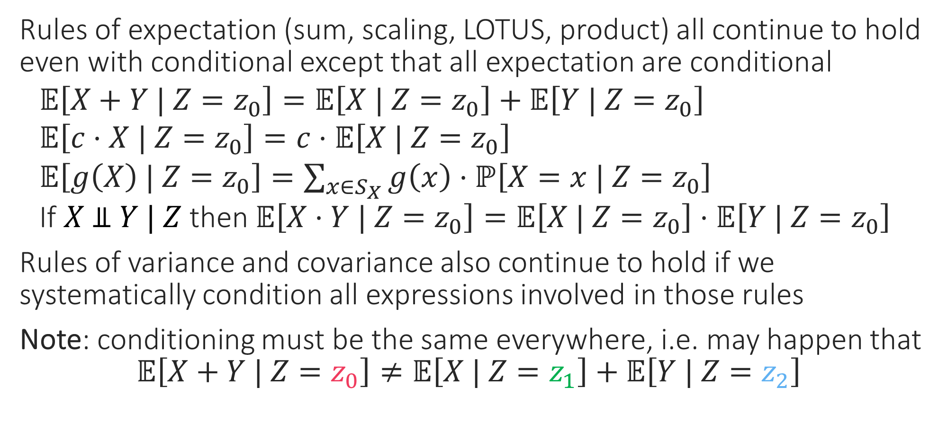
Conditional Statistics
Rules of expectation (sum, scaling, LOTUS, product) all continue to hold even with conditional except that all expectation are conditional
$𝔼\left[X+Y | Z=z_{0}\right]=𝔼\left[X | Z=z_{0}\right]+𝔼\left[Y | Z=z_{0}\right]$
$𝔼\left[c⋅X | Z=z_{0}\right]=c⋅𝔼\left[X | Z=z_{0}\right]$
$𝔼\left[g\left(X\right) | Z=z_{0}\right]=\sum_{x∈S_{X}}{g\left(x\right)⋅ℙ\left[X=x | Z=z_{0}\right]}$
If $X \text{⫫} Y | Z$ then $𝔼\left[X⋅Y | Z=z_{0}\right]=𝔼\left[X | Z=z_{0}\right]⋅𝔼\left[Y | Z=z_{0}\right]$
Rules of variance and covariance also continue to hold if we systematically condition all expressions involved in those rules
Note: conditioning must be the same everywhere, i.e. may happen that
$$𝔼\left[X+Y | Z=z_{0}\right]≠𝔼\left[X | Z=z_{1}\right]+𝔼\left[Y | Z=z_{2}\right]$$

Slide 19
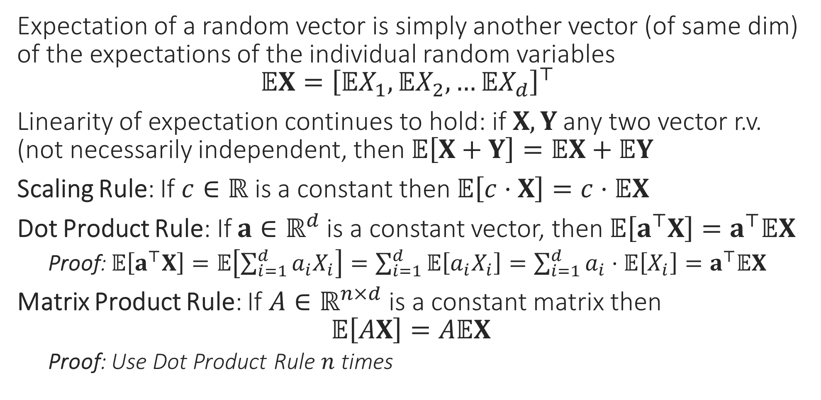
Statistics of Random Vectors
Expectation of a random vector is simply another vector (of same dim) of the expectations of the individual random variables $𝔼X={\left[𝔼X_{1},𝔼X_{2},…𝔼X_{d}\right]}^{⊤}$
Linearity of expectation continues to hold: if $X,Y$ any two vector r.v. (not necessarily independent, then $𝔼\left[X+Y\right]=𝔼X+𝔼Y$
Scaling Rule: If $c∈ℝ$ is a constant then $𝔼\left[c⋅X\right]=c⋅𝔼X$
Dot Product Rule: If $a∈ℝ^{d}$ is a constant vector, then $𝔼\left[a^{⊤}X\right]=a^{⊤}𝔼X$
Proof: $𝔼\left[a^{⊤}X\right]=𝔼\left[\sum_{i=1}^{d}{a_{i}X_{i}}\right]=\sum_{i=1}^{d}{𝔼\left[a_{i}X_{i}\right]}=\sum_{i=1}^{d}{a_{i}⋅𝔼\left[X_{i}\right]}=a^{⊤}𝔼X$
Matrix Product Rule: If $A∈ℝ^{n×d}$ is a constant matrix then $𝔼\left[AX\right]=A𝔼X$
Proof: Use Dot Product Rule $n$ times

Slide 20
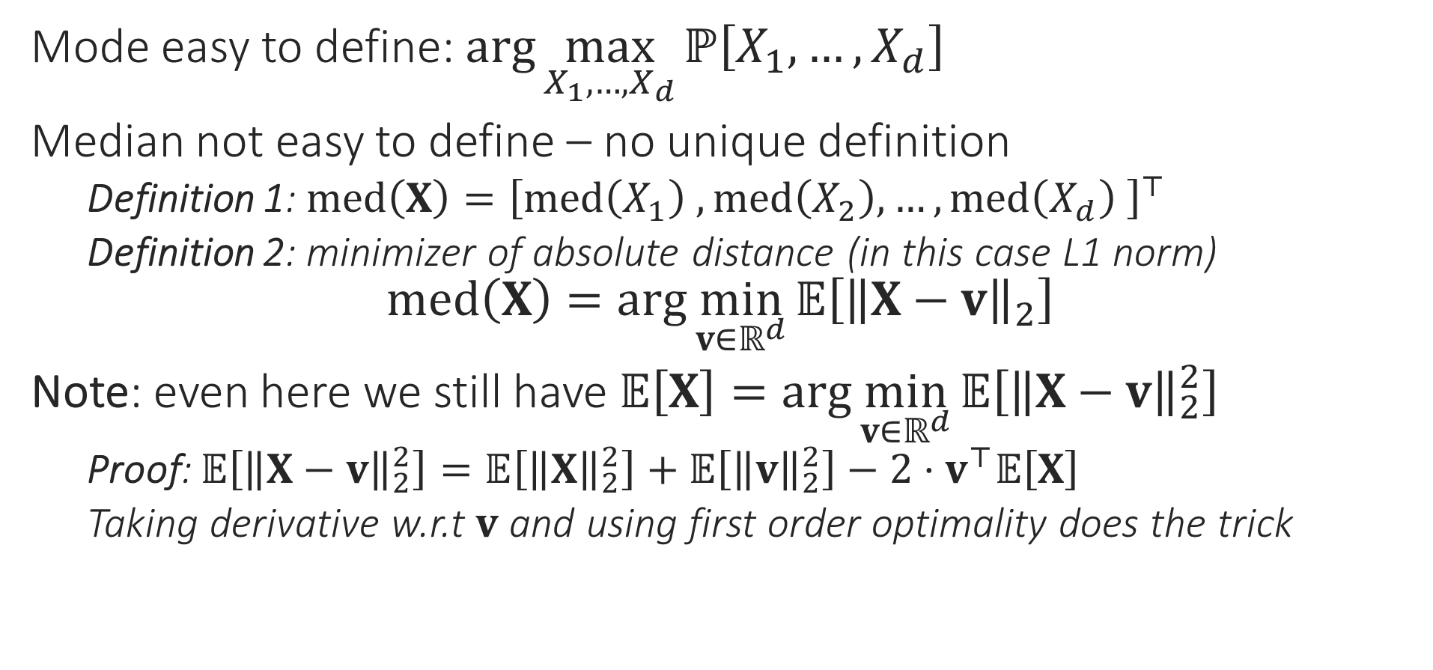
Statistics of Random Vectors
Mode easy to define: $\arg{\max_{X_{1},…,X_{d}}{ℙ\left[X_{1},…,X_{d}\right]}}$
Median not easy to define – no unique definition
Definition 1: $med\left(X\right)={\left[med\left(X_{1}\right) ,med\left(X_{2}\right),…,med\left(X_{d}\right) \right]}^{⊤}$
Definition 2: minimizer of absolute distance (in this case L1 norm) $med\left(X\right)=\arg{\min_{v∈ℝ^{d}}{𝔼\left[{\left\|X−v\right\|}_{2}\right]}}$
Note: even here we still have $𝔼\left[X\right]=\arg{\min_{v∈ℝ^{d}}{𝔼\left[{\left\|X−v\right\|}_{2}^{2}\right]}}$
Proof: $𝔼\left[{\left\|X−v\right\|}_{2}^{2}\right]=𝔼\left[{\left\|X\right\|}_{2}^{2}\right]+𝔼\left[{\left\|v\right\|}_{2}^{2}\right]−2⋅v^{⊤}𝔼\left[X\right]$
Taking derivative w.r.t $v$ and using first order optimality does the trick

Slide 21


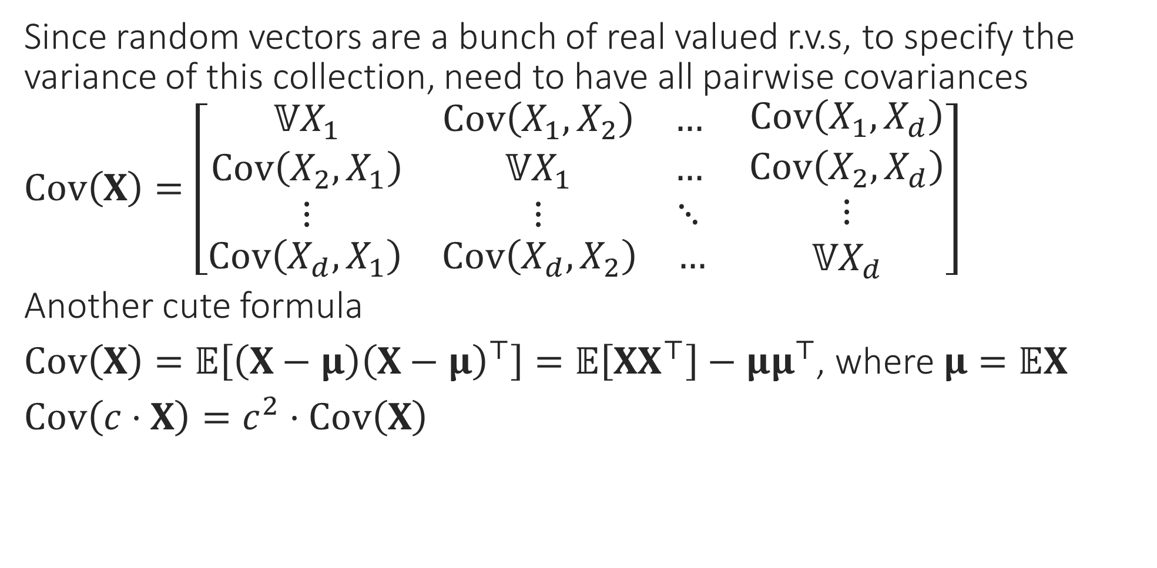
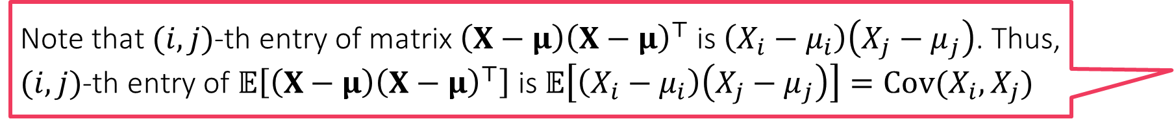
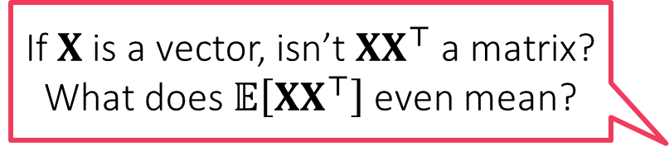
Statistics of Random Vectors
If $X$ is a vector, isn’t $XX^{⊤}$ a matrix? What does $𝔼\left[XX^{⊤}\right]$ even mean?
Since random vectors are a bunch of real valued r.v.s, to specify the variance of this collection, need to have all pairwise covariances
$Cov\left(X\right)=\left[\begin{aligned}\begin{matrix}𝕍X_{1} & Cov\left(X_{1},X_{2}\right) & … \\ Cov\left(X_{2},X_{1}\right) & 𝕍X_{1} & … \\ ⋮ & ⋮ & ⋱\end{matrix} \\ \begin{matrix}Cov\left(X_{d},X_{1}\right) & Cov\left(X_{d},X_{2}\right) & …\end{matrix}\end{aligned} \begin{matrix}Cov\left(X_{1},X_{d}\right) \\ Cov\left(X_{2},X_{d}\right) \\ \begin{aligned}⋮ \\ 𝕍X_{d}\end{aligned}\end{matrix}\right]$
Another cute formula
$Cov\left(X\right)=𝔼\left[\left(X−μ\right){\left(X−μ\right)}^{⊤}\right]=𝔼\left[XX^{⊤}\right]−μμ^{⊤}$, where $μ=𝔼X$
$Cov\left(c⋅X\right)=c^{2}⋅Cov\left(X\right)$
Just as a random vector is a collection of random variables arranged as a 1D array, a random matrix is a collection of r.v.s arranged as a 2D array!
Note that $(i,j)$-th entry of matrix $\left(X−μ\right){\left(X−μ\right)}^{⊤}$ is $\left(X_{i}−μ_{i}\right)\left(X_{j}−μ_{j}\right)$. Thus, $(i,j)$-th entry of $𝔼\left[\left(X−μ\right){\left(X−μ\right)}^{⊤}\right]$ is $𝔼\left[\left(X_{i}−μ_{i}\right)\left(X_{j}−μ_{j}\right)\right]=Cov(X_{i},X_{j})$

Slide 22
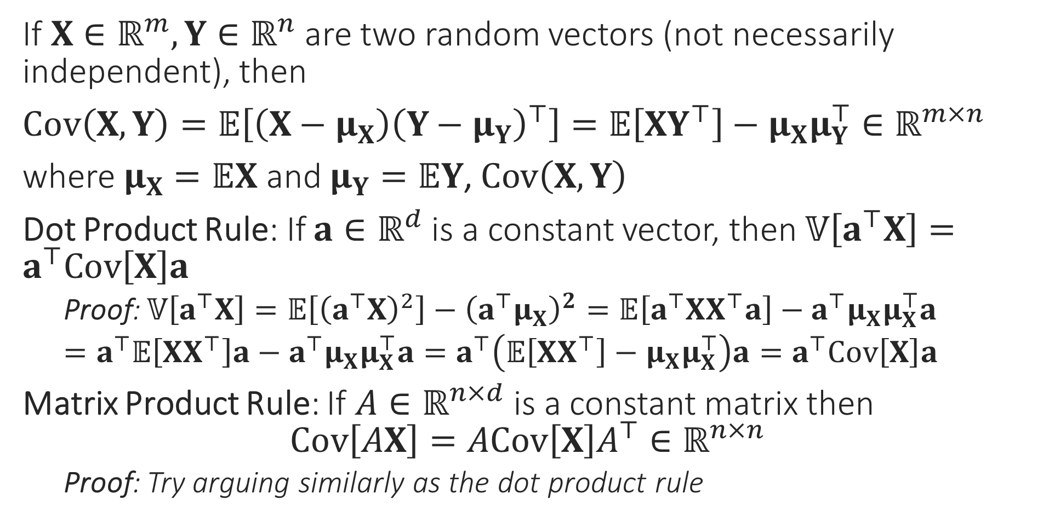
Useful Operations on Vector R.V.
Can you prove that the covariance matrix of any random vector is always a PSD matrix?
If $X∈ℝ^{m},Y∈ℝ^{n}$ are two random vectors (not necessarily independent), then
$Cov\left(X,Y\right)=𝔼\left[\left(X−μ_{X}\right){\left(Y−μ_{Y}\right)}^{⊤}\right]=𝔼\left[XY^{⊤}\right]−μ_{X}μ_{Y}^{⊤}∈ℝ^{m×n}$
where $μ_{X}=𝔼X$ and $μ_{Y}=𝔼Y$, $Cov\left(X,Y\right)$
Dot Product Rule: If $a∈ℝ^{d}$ is a constant vector, then $𝕍\left[a^{⊤}X\right]=a^{⊤}Cov\left[X\right]a$
Proof: $𝕍\left[a^{⊤}X\right]=𝔼\left[{\left(a^{⊤}X\right)}^{2}\right]−{\left(a^{⊤}μ_{X}\right)}^{2}=𝔼\left[a^{⊤}XX^{⊤}a\right]−a^{⊤}μ_{X}μ_{X}^{⊤}a$
$=a^{⊤}𝔼\left[XX^{⊤}\right]a−a^{⊤}μ_{X}μ_{X}^{⊤}a=a^{⊤}\left(𝔼\left[XX^{⊤}\right]−μ_{X}μ_{X}^{⊤}\right)a=a^{⊤}Cov\left[X\right]a$
Matrix Product Rule: If $A∈ℝ^{n×d}$ is a constant matrix then $Cov\left[AX\right]=ACov\left[X\right]A^{⊤}∈ℝ^{n×n}$
Proof: Try arguing similarly as the dot product rule

Slide 23


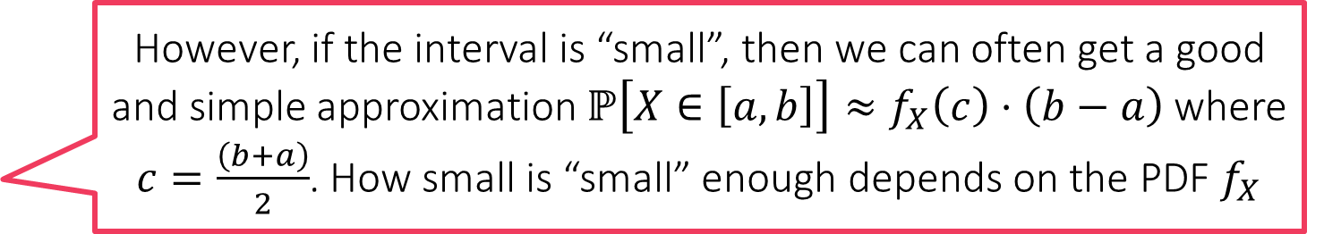
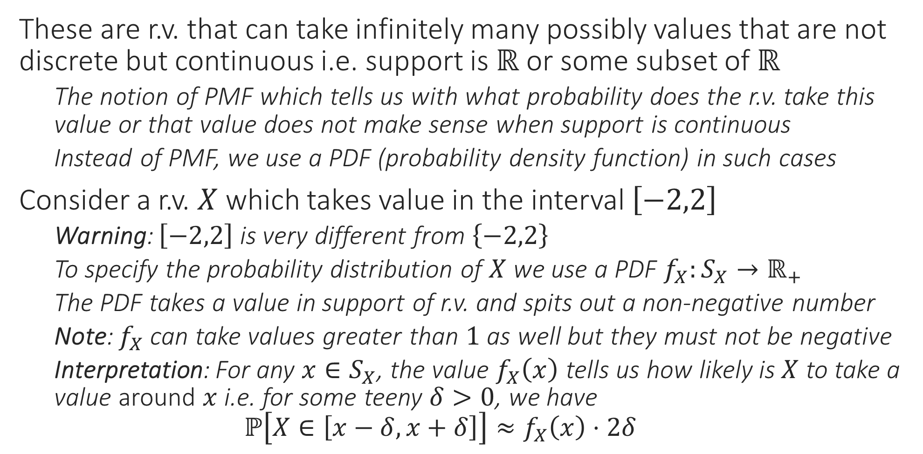
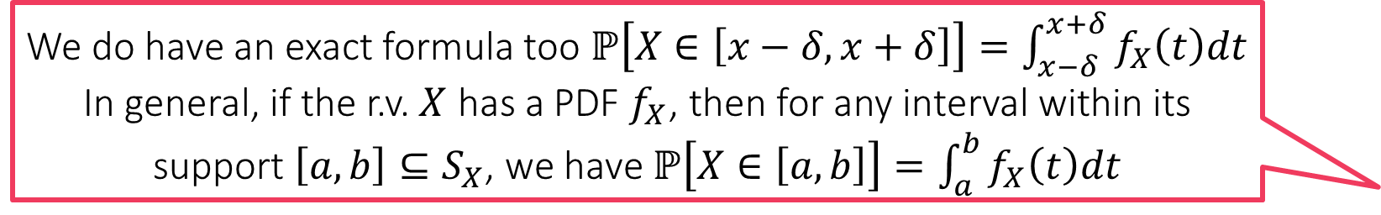

Continuous Random Variables
These are r.v. that can take infinitely many possibly values that are not discrete but continuous i.e. support is $ℝ$ or some subset of $ℝ$
The notion of PMF which tells us with what probability does the r.v. take this value or that value does not make sense when support is continuous
Instead of PMF, we use a PDF (probability density function) in such cases
Consider a r.v. $X$ which takes value in the interval $\left[−2,2\right]$
Warning: $\left[−2,2\right]$ is very different from $\left\{−2,2\right\}$
To specify the probability distribution of $X$ we use a PDF $f_{X}:S_{X}→ℝ_{+}$
The PDF takes a value in support of r.v. and spits out a non-negative number
Note: $f_{X}$ can take values greater than $1$ as well but they must not be negative
Interpretation: For any $x∈S_{X}$, the value $f_{X}\left(x\right)$ tells us how likely is $X$ to take a value around $x$ i.e. for some teeny $δ>0$, we have $ℙ\left[X∈\left[x−δ,x+δ\right]\right]≈f_{X}\left(x\right)⋅2δ$
Why $≈$ why not $=$ ?
We do have an exact formula too $ℙ\left[X∈\left[x−δ,x+δ\right]\right]=\int_{x−δ}^{x+δ}{f_{X}\left(t\right)dt}$
In general, if the r.v. $X$ has a PDF $f_{X}$, then for any interval within its support $\left[a,b\right]⊆S_{X}$, we have $ℙ\left[X∈\left[a,b\right]\right]=\int_{a}^{b}{f_{X}\left(t\right)dt}$
However, if the interval is “small”, then we can often get a good and simple approximation $ℙ\left[X∈\left[a,b\right]\right]≈f_{X}\left(c\right)⋅\left(b−a\right)$ where $c=\frac{\left(b+a\right)}{2}$. How small is “small” enough depends on the PDF $f_{X}$

Slide 24
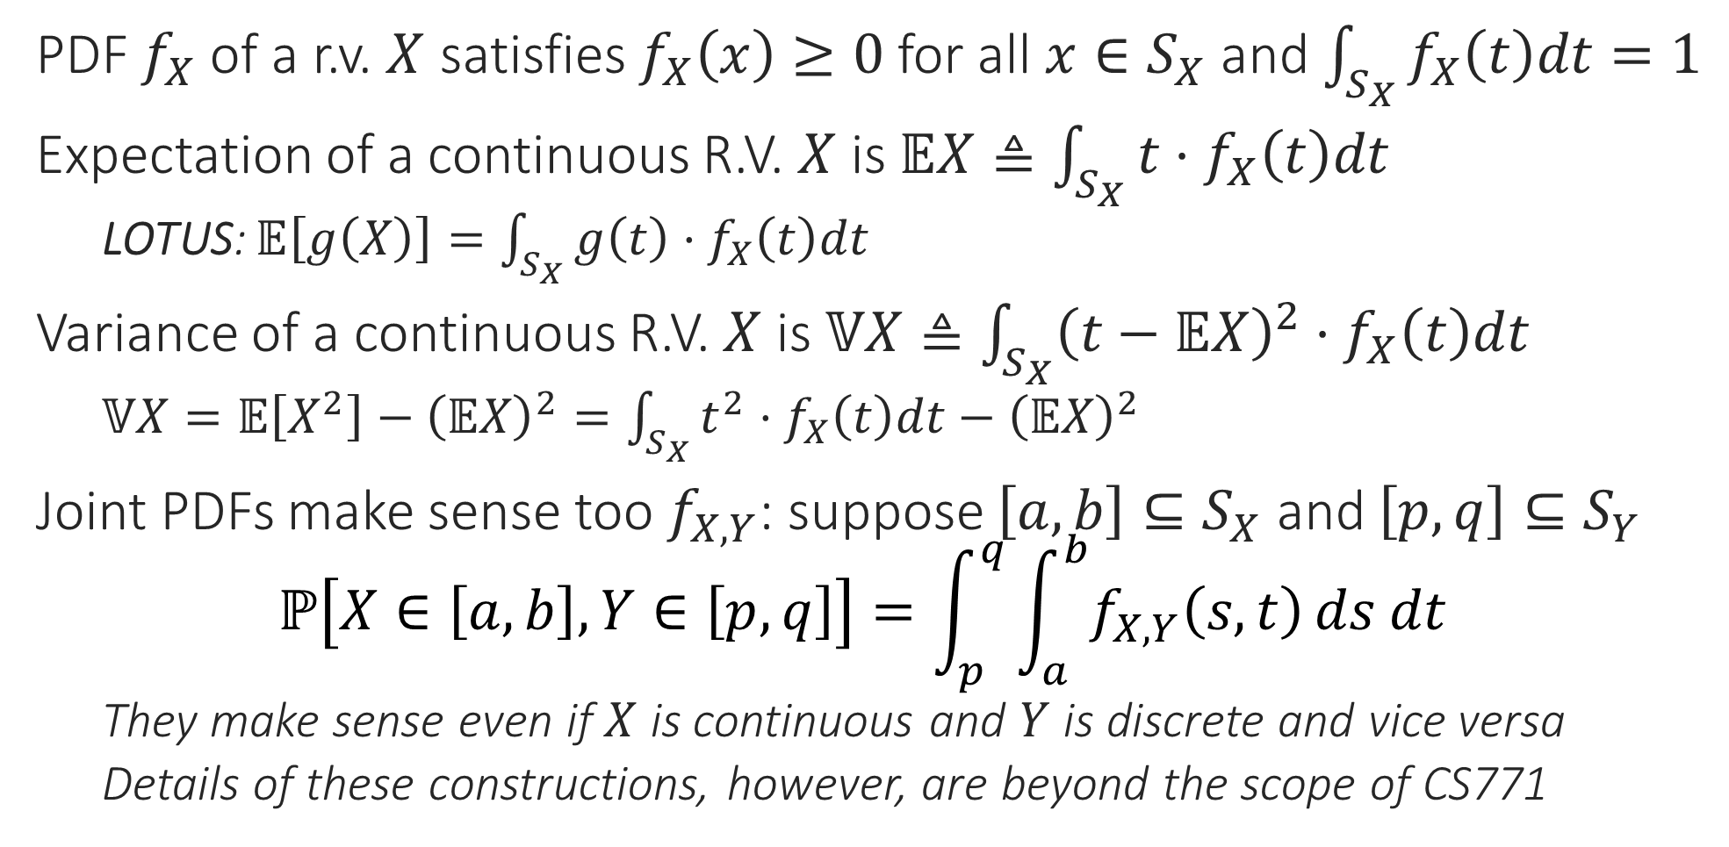
Continuous R.V.s– the Rules Revisited
PDF $f_{X}$ of a r.v. $X$ satisfies $f_{X}\left(x\right)≥0$ for all $x∈S_{X}$ and $\int_{S_{X}}{f_{X}\left(t\right)dt}=1$
Expectation of a continuous R.V. $X$ is $𝔼X≜\int_{S_{X}}{t⋅f_{X}\left(t\right)dt}$
LOTUS: $𝔼\left[g\left(X\right)\right]=\int_{S_{X}}{g\left(t\right)⋅f_{X}\left(t\right)dt}$
Variance of a continuous R.V. $X$ is $𝕍X≜\int_{S_{X}}{{\left(t−𝔼X\right)}^{2}⋅f_{X}\left(t\right)dt}$
$𝕍X=𝔼\left[X^{2}\right]−{\left(𝔼X\right)}^{2}=\int_{S_{X}}{t^{2}⋅f_{X}\left(t\right)dt}−{\left(𝔼X\right)}^{2}$
Joint PDFs make sense too $f_{X,Y}$: suppose $\left[a,b\right]⊆S_{X}$ and $\left[p,q\right]⊆S_{Y}$ $ℙ\left[X∈\left[a,b\right],Y∈\left[p,q\right]\right]=\int_{p}^{q}{\int_{a}^{b}{f_{X,Y}\left(s,t\right)}ds dt}$
They make sense even if $X$ is continuous and $Y$ is discrete and vice versa
Details of these constructions, however, are beyond the scope of CS771

Slide 25

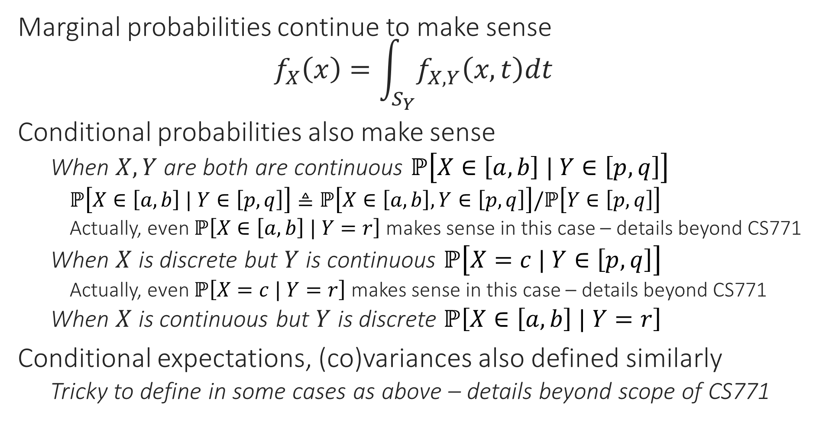

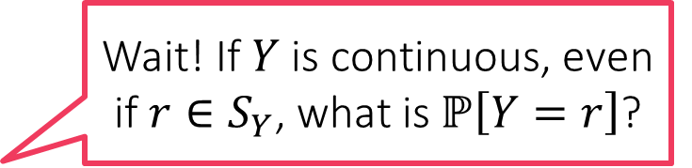
Continuous R.V.s– the Rules Revisited
Wait! If $Y$ is continuous, even if $r∈S_{Y}$, what is $ℙ\left[Y=r\right]$?
Marginal probabilities continue to make sense $f_{X}\left(x\right)=\int_{S_{Y}}{f_{X,Y}\left(x,t\right)dt}$
Conditional probabilities also make sense
When $X,Y$ are both are continuous $ℙ\left[X∈\left[a,b\right] | Y∈\left[p,q\right]\right]$
$ℙ\left[X∈\left[a,b\right] | Y∈\left[p,q\right]\right]≜ℙ\left[X∈\left[a,b\right],Y∈\left[p,q\right]\right]/ℙ\left[Y∈\left[p,q\right]\right]$
Actually, even $ℙ\left[X∈\left[a,b\right] | Y=r\right]$ makes sense in this case – details beyond CS771
When $X$ is discrete but $Y$ is continuous $ℙ\left[X=c | Y∈\left[p,q\right]\right]$
Actually, even $ℙ\left[X=c | Y=r\right]$ makes sense in this case – details beyond CS771
When $X$ is continuous but $Y$ is discrete $ℙ\left[X∈\left[a,b\right] | Y=r\right]$
Conditional expectations, (co)variances also defined similarly
Tricky to define in some cases as above – details beyond scope of CS771
In general $ℙ\left[Y=r\right]=0$ in such cases and you would be right to suspect a divide-by-zero problem here. However, it is possible to still define $ℙ\left[X∈\left[a,b\right] | Y=r\right]$ using limits or a powerful technique called the Radon-Nikodym derivative

Slide 26
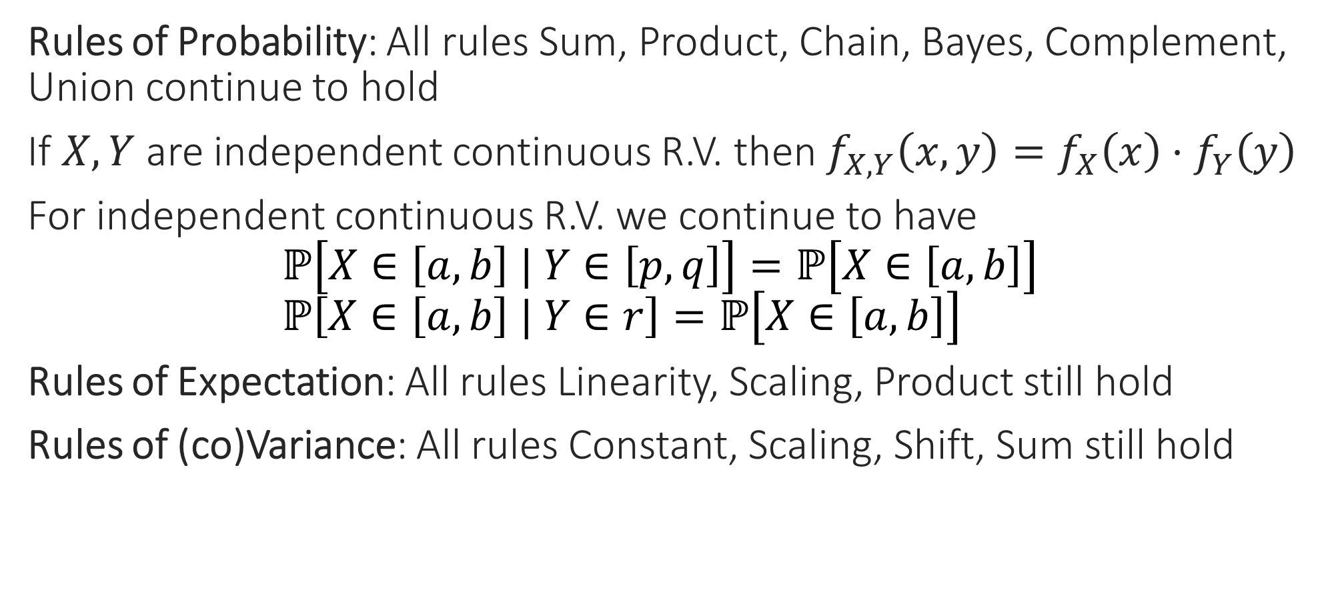
Continuous R.V.s– the Rules Revisited
Rules of Probability: All rules Sum, Product, Chain, Bayes, Complement, Union continue to hold
If $X,Y$ are independent continuous R.V. then $f_{X,Y}\left(x,y\right)=f_{X}\left(x\right)⋅f_{Y}\left(y\right)$
For independent continuous R.V. we continue to have $ℙ\left[X∈\left[a,b\right] | Y∈\left[p,q\right]\right]=ℙ\left[X∈\left[a,b\right]\right]$ $ℙ\left[X∈\left[a,b\right] | Y∈r\right]=ℙ\left[X∈\left[a,b\right]\right]$
Rules of Expectation: All rules Linearity, Scaling, Product still hold
Rules of (co)Variance: All rules Constant, Scaling, Shift, Sum still hold

Slide 27
Probability Distributions
Some distributions popularly used in ML
Discrete distributions: Bernoulli, Rademacher
Continuous distributions: Uniform, Gaussian, Laplacian
Some of their properties such as mean, median etc
Notion of a parametric distribution

Slide 28
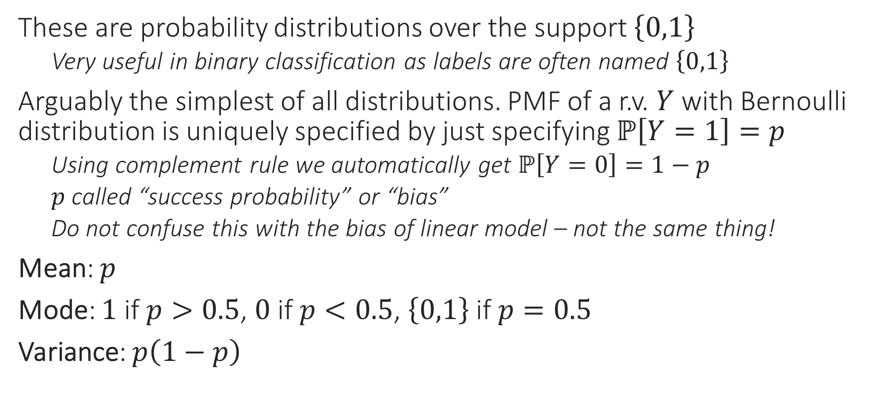
Bernoulli Distributions
These are probability distributions over the support $\left\{0,1\right\}$
Very useful in binary classification as labels are often named $\left\{0,1\right\}$
Arguably the simplest of all distributions. PMF of a r.v. $Y$ with Bernoulli distribution is uniquely specified by just specifying $ℙ\left[Y=1\right]=p$
Using complement rule we automatically get $ℙ\left[Y=0\right]=1−p$
$p$ called “success probability” or “bias”
Do not confuse this with the bias of linear model – not the same thing!
Mean: $p$
Mode: $1$ if $p>0.5$, $0$ if $p<0.5$, $\left\{0,1\right\}$ if $p=0.5$
Variance: $p\left(1−p\right)$

Slide 29
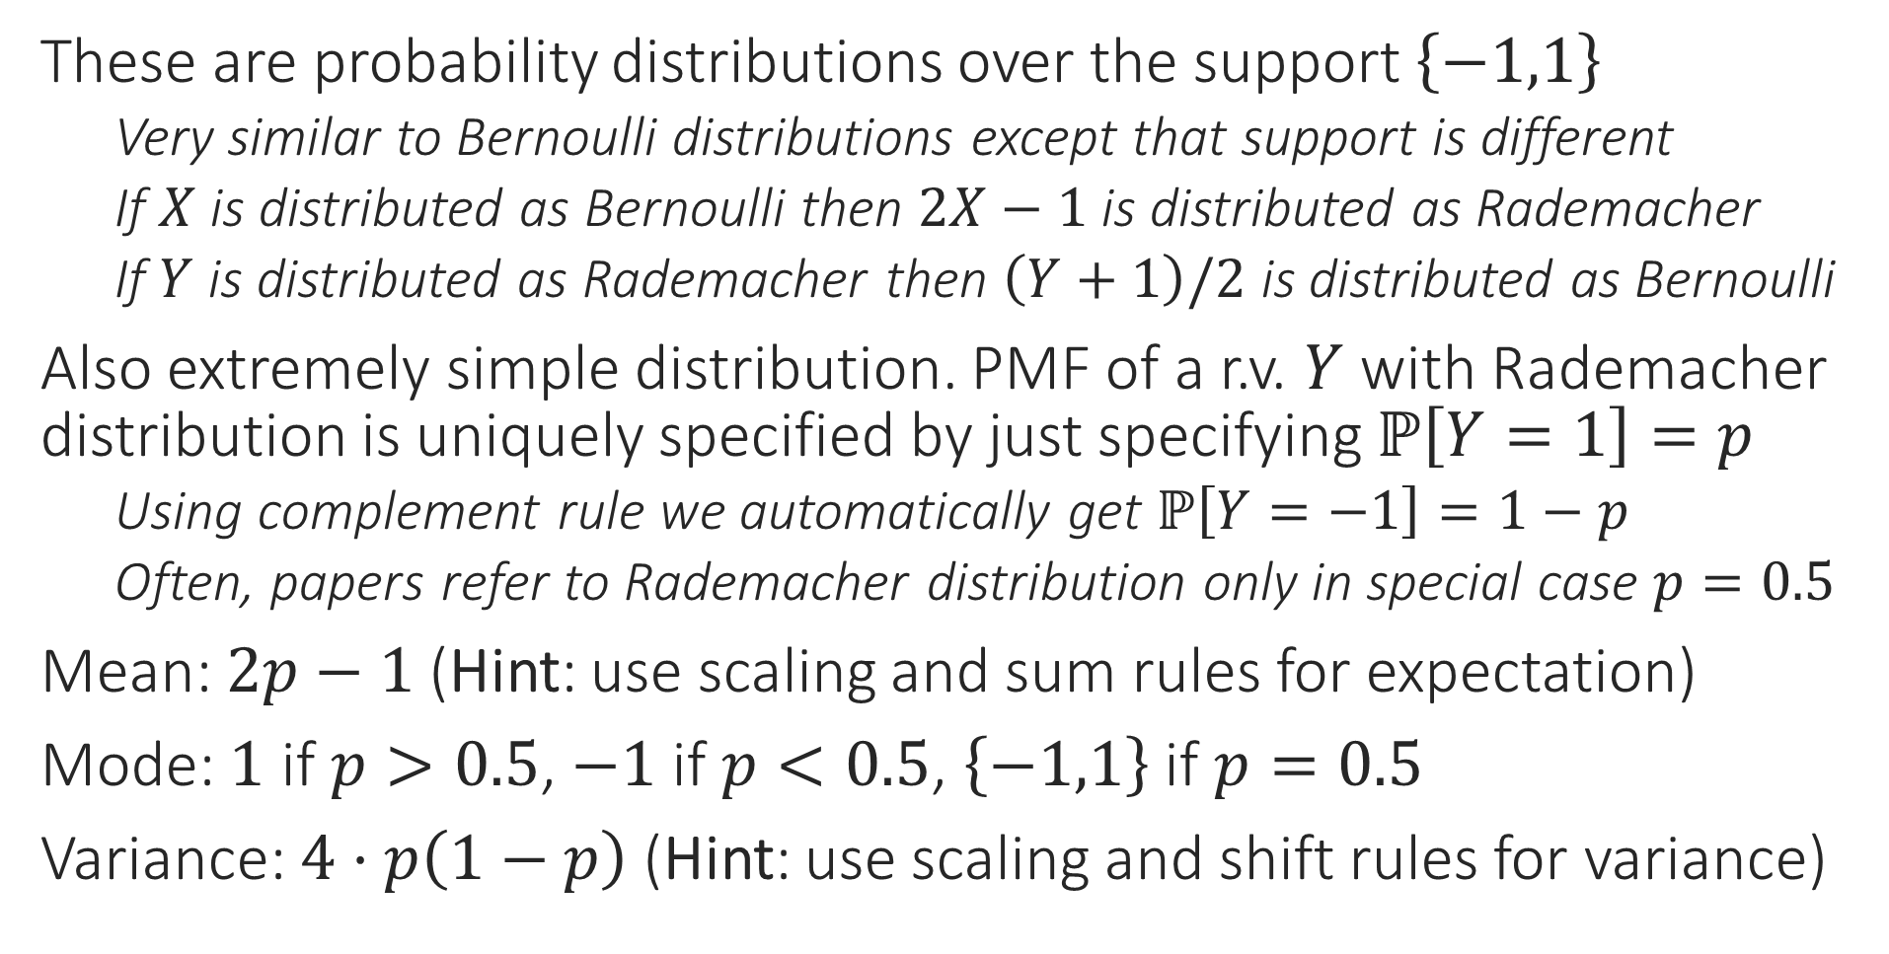
Rademacher Distributions
These are probability distributions over the support $\left\{−1,1\right\}$
Very similar to Bernoulli distributions except that support is different
If $X$ is distributed as Bernoulli then $2X−1$ is distributed as Rademacher
If $Y$ is distributed as Rademacher then $\left(Y+1\right)/2$ is distributed as Bernoulli
Also extremely simple distribution. PMF of a r.v. $Y$ with Rademacher distribution is uniquely specified by just specifying $ℙ\left[Y=1\right]=p$
Using complement rule we automatically get $ℙ\left[Y=−1\right]=1−p$
Often, papers refer to Rademacher distribution only in special case $p=0.5$
Mean: $2p−1$ (Hint: use scaling and sum rules for expectation)
Mode: $1$ if $p>0.5$, $−1$ if $p<0.5$, $\left\{−1,1\right\}$ if $p=0.5$
Variance: $4⋅p\left(1−p\right)$ (Hint: use scaling and shift rules for variance)

Slide 30

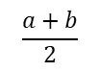
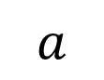
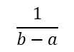
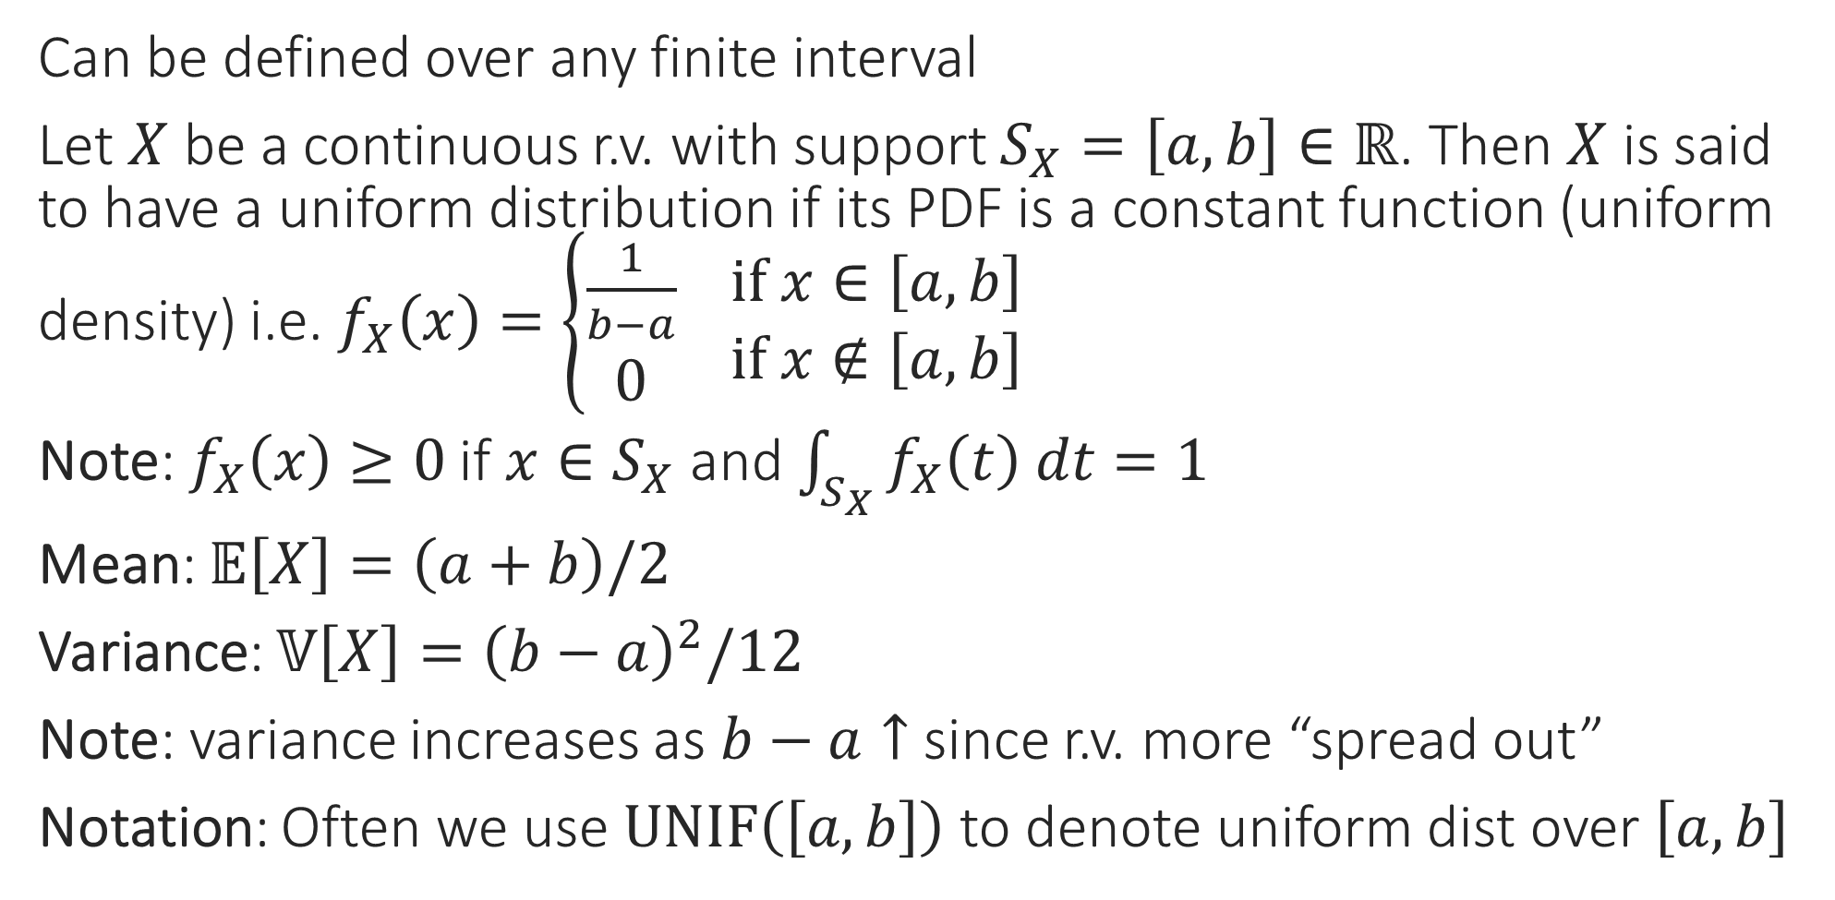
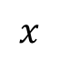
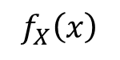


Uniform Distribution
Recall that we commented that although we must have $f_{X}\left(x\right)>0$, we need not have $f_{X}\left(x\right)≤1$. Note that if in the uniform case, if we have $b−a<1$ then indeed $f_{X}\left(x\right)>1$ and its perfectly fine
Can be defined over any finite interval
Let $X$ be a continuous r.v. with support $S_{X}=\left[a,b\right]∈ℝ$. Then $X$ is said to have a uniform distribution if its PDF is a constant function (uniform density) i.e. $f_{X}\left(x\right)=\left\{\begin{aligned}\frac{1}{b−a} \\ 0\end{aligned} \begin{matrix}if x∈\left[a,b\right] \\ if x∉\left[a,b\right]\end{matrix}\right.$
Note: $f_{X}\left(x\right)≥0$ if $x∈S_{X}$ and $\int_{S_{X}}{f_{X}\left(t\right) dt}=1$
Mean: $𝔼\left[X\right]=\left(a+b\right)/2$
Variance: $𝕍\left[X\right]={\left(b−a\right)}^{2}/12$
Note: variance increases as $b−a↑$ since r.v. more “spread out”
Notation: Often we use $UNIF\left(\left[a,b\right]\right)$ to denote uniform dist over $\left[a,b\right]$
$$f_{X}\left(x\right)$$
$$\frac{1}{b−a}$$
$$a$$
$$\frac{a+b}{2}$$
$$b$$
$$x$$

Slide 31




Gaussian (aka Normal) Distributions
Arguably one of the most popular of all probability distributions
Models our intuitive assumption that in real life, data often takes values around its mean value and it gets unlikely to witness extreme values
A fundamental result in probability theory – the law of large numbers –shows that some form of this is indeed true

Slide 32






Gaussian Distributions
Indeed! Look at these two Gaussians. The one on the left seems more “spread-out” and the one on the right seems very “squeezed-in”. This happened because $σ_{3}>σ_{1}>σ_{2}$
Specifying a Bernoulli/Rademacher distribution took two numbers,
Specifying a categorical distbn over $C$ elements takes $C−1$ numbers
Specifying a Gaussian distribution over $ℝ$ requires two numbers
$μ$: must be a real number (may be negative or positive or even zero)
$σ^{2}$: must be a non-negative real number
Notation: PDF for a Gaussian r.v. $X$ i.e. $f_{X}\left[X | μ,σ^{2}\right]$ is often written as $𝒩_{X}\left(x;μ,σ^{2}\right)$ or simply as $𝒩\left(x;μ,σ^{2}\right)$
Notice that even here we condition on constants (either using $|$ or $;$ symbol)
The notation is no accident – if the PDF of a r.v. $X$ is $𝒩_{X}\left(x;μ,σ^{2}\right)$, then
$𝔼\left[X\right]=μ$ = Mode = Median, as well as $𝕍\left[X\right]=σ^{2}$
Requires a bit of integration to prove these results ☺

Slide 33



Operations with Gaussians
Note: we can derive results such as $𝔼W=μ_{X}+μ_{Y}$ and $𝕍W=σ_{X}^{2}+σ_{Y}^{2}$ using rules we studied earlier. However, those rules do not assure us that $W$ must be Gaussian (they just assure us that $W$ is some r.v. with such and such mean and variance. It takes special analysis to show that $Z,W,V$ etc are Gaussian r.v. too!
Since integration can be a pain, some handy results about Gaussians
Let $X,Y$ be two independent r.v. whose PDF is Gaussian i.e. $𝒩_{X}\left(⋅ ;μ_{X},σ_{X}^{2}\right)$ and $𝒩_{Y}\left(⋅ ;μ_{Y},σ_{Y}^{2}\right)$. Then we have
Scaling Rule: If $Z=c⋅X$ then $Z$ is also Gaussian $𝒩_{Z}\left(⋅ ;c⋅μ_{X},c^{2}⋅σ_{X}^{2}\right)$
Sum Rule: If $W=X+Y$ then $W$ is also Gaussian too $𝒩_{W}\left(⋅ ;μ_{X}+μ_{Y},σ_{X}^{2}+σ_{Y}^{2}\right)$
Shift Rule: If $V=X+c$ ($c$ const) then $V$ is Gaussian $𝒩_{V}\left(⋅ ;μ_{X}+c,σ_{X}^{2}\right)$
Tail Rule: $\left\{ℙ\left[X≥μ_{X}+t⋅σ_{X}\right]=ℙ\left[X≤μ_{X}−t⋅σ_{X}\right]\right\}≤e^{−t^{2}/2}$
It gets exponentially less likely that a Gaussian r.v. takes value far from mean
For $t=5$, we have $ℙ\left[\left|X−μ_{X}\right|≥5⋅σ_{X}\right]<0.000004$ (5-sigma rule)
As $σ_{X}↓$ the r.v. gets more and more concentrated around its mean
The colloquial “68-95-99.7 rule” describes this more generally
$$ℙ\left[\left|X−μ_{X}\right|≤σ_{X}\right]≈0.68$$
$$ℙ\left[\left|X−μ_{X}\right|≤{2⋅σ}_{X}\right]≈0.95$$
$$ℙ\left[\left|X−μ_{X}\right|≤{3⋅σ}_{X}\right]≈0.997$$
Be careful that this rule apples only to the Gaussian distribution. A random variable sampled from some other distribution may very well violate this rule. People often cite the 68-95-99.7 rule to make real-life predictions. This is merely an approximation (possibly a good one, possibly a bad one) based on an assumption that the real life distribution is approximately Gaussian

Slide 34

Gaussian Random Vector
As in the scalar case, the multivariate Gaussian requires just the mean $μ∈ℝ^{d}$ and the covariance $Σ∈ℝ^{d×d}$ to be specified $𝒩\left(μ,Σ\right)$
$ℙ\left[x | μ,Σ\right]=\frac{1}{\sqrt{{\left(2π\right)}^{d}\left|Σ\right|}}\exp\left(−\frac{1}{2}{\left(x−μ\right)}^{⊤}Σ^{−1}(x−μ)\right)$
Special case $μ=0$ and $Σ=I_{d}$ called standard Gaussian/Normal dist
$ℙ\left[x | 0,I_{d}\right]=\frac{1}{\sqrt{{\left(2π\right)}^{d}}}\exp\left(−\frac{1}{2}{\left\|x\right\|}_{2}^{2}\right)=\prod_{i=1}^{d}{\frac{1}{\sqrt{2π}}\exp\left(−\frac{1}{2}x_{i}^{2}\right)}$
However, $\frac{1}{\sqrt{2π}}\exp\left(−\frac{1}{2}x_{i}^{2}\right)$ is simply $𝒩\left(0,1\right)$ i.e. we indeed have $ℙ\left[x_{1},…,x_{d} | 0,I\right]=\prod_{i=1}^{d}{ℙ\left[x_{i} | 0,1\right]}$
All $d$ coordinates of a standard Gaussian r.v. are independent!

Slide 35


Gaussian Random Vector
Note: Just as before, we can derive results such as $𝔼\left[a^{⊤}x\right]=μ^{⊤}x$ and $𝕍\left[a^{⊤}x\right]=a^{⊤}Σa$ using rules we studied earlier. However, those rules do not assure us that $a^{⊤}x$ or $Ax$ must be Gaussian (they just assure us that these are some r.v./r.vec. with such and such mean and (co)-variance. It takes a more detailed analysis to show that these are actually Gaussian.
Given a (possibly non-standard) Gaussian vector $ℝ^{d}∋x∼𝒩\left(μ,Σ\right)$
Every coordinate of $x$ is a (real valued) Gaussian r.v. – warning: coordinates need not be independent if the Gaussian is non-standard
The above holds true even if conditioned on all other coordinates of $x$
Consider any coordinate of the vector, say $j∈\left[d\right]$
$x_{j}$ is distributed as the Gaussian $𝒩\left(μ_{j},Σ_{jj}\right)$
Given values ${x_{k}=v}_{k}$ for all other coordinates $k≠j$, $x_{j}$ is still Gaussian
Expression a bit complicated – refer to DFO Sec 6.5.1 (see the reference section on the course webpage)
If $a∈ℝ^{d}$ is a constant vector, then $ℝ∋a^{⊤}x∼𝒩\left(μ^{⊤}a,a^{⊤}Σa\right)$
If $A∈ℝ^{n×d}$ is a constant matrix then $ℝ^{d}∋Ax∼𝒩\left(Aμ,AΣA^{⊤}\right)$

Slide 36




Laplacian Distribution
If $X$ is a r.v. with a Laplacian PDF with parameters $μ_{X},σ_{X}$, then $Y=a⋅X+b$ (where $a,b$ are constants) is also a Laplacian r.v. but with parameters $μ_{Y}=a⋅μ_{X}+b$ and $σ_{Y}=a⋅σ_{Y}$
Close cousins of Gaussian distributions except that a Laplacian r.v. concentrates much more strongly around its mean than a Gaussian r.v.
Also require two parameters to be specified $μ∈ℝ,σ≥0$
Mean = Mode = Median: $μ$, Variance: $2σ^{2}$

Slide 37

Parametric Distributions
Parametric distributions are extremely important for ML. We will next learn about algorithms that try to make realistic predictions by first learning a parametric distribution that mimics reality. This is done by learning the parameters of the distribution using data
Certain distributions are parametric – this means that there are a finite number of parameters that completely describe the distribution
Similar to parametric models like LwP or linear models where a finite number of parameters (e.g. a model vector and a bias value) describe the model fully
There exist non-parametric distributions too (beyond scope of CS771)
Bernoulli/Rademacher ($p$), Uniform ($a,b$), Gaussian ($μ,σ^{2}$), Laplacian ($μ,σ$)
Statistics: apart from the name of a branch of mathematics, the word “statistic” also refers to some quantity we calculate using samples
E.g. sample mean, sample variance, sample mode, sample median
A common usage of statistics is to estimate parameters of the distribution that generated those samples
E.g. under some mild conditions, sample mean/variance is a good estimate of the expectation/variance of distribution that generated the samples
Notes:
Help has been taken from slides of Prof. Purushottam Kar

